Slide 1

Banks Road
BULLYING is NOT Tolerated
Banks Road Infant and Nursery School
There are no bystanders at Banks Road!

Slide 2

Bullying
Bullying is intentional (not an accident) a bully hurts someone on purpose.
Bullying is repetitive. This means that the bully hurts someone over and over again, it isn’t an incident that happens only once.
In general, bullying is where one person acts like they have more power than another, and does whatever they can to hurt that person.

Slide 3
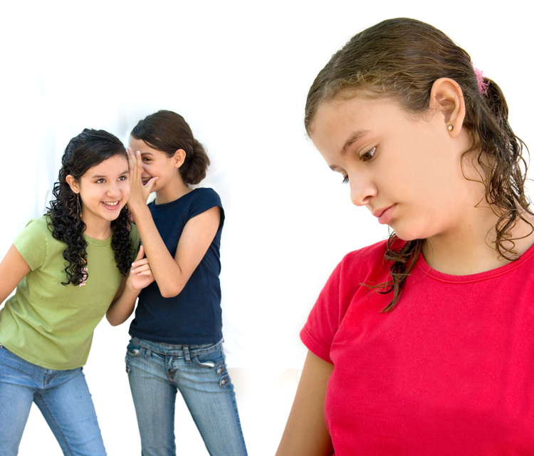
Bullying
Bullying can happen in many forms, I am going to show you a few and tell you what to do if you see anyone being bullied or if you are being bullied.

Slide 4
Physical
Bullies want to hurt people to make themselves feel better.
This can include kicking, punching, pushing, pulling hair and many more awful things.
If you see someone being hurt...
TELL AN ADULT!

Slide 5
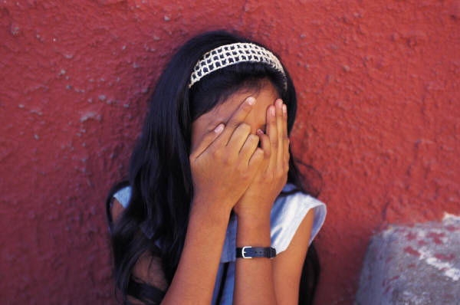
Emotional
This is when children can be left out and saying things behind people’s backs like spreading nasty, often untrue, stories
Bullies like being in charge
If they see someone smaller than they are or different to them they will often go out of their way to be horrible to them.
They can make other people be horrible to them too!

Slide 6
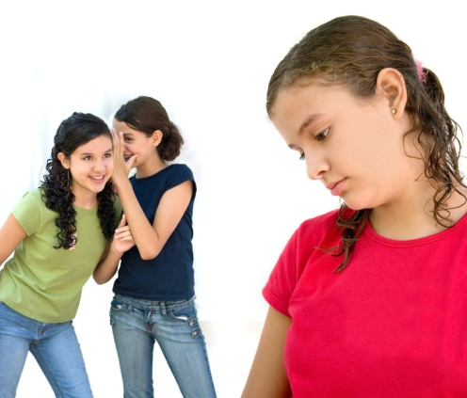
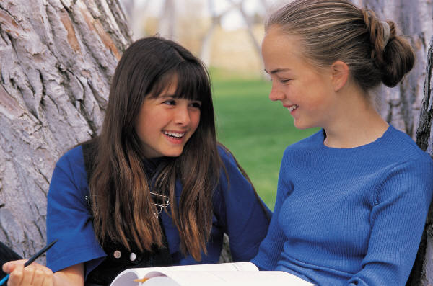
Emotional
How would you feel if you were left out?
How would you feel if a group kept coming up to you and saying awful things?
Here at Banks Road we………
Treat people how we
would like to be treated!!!

Slide 7
Verbal bullying
Calling people names, threatening people, singing unkind songs, tormenting children and spreading nasty, often untrue stories are all forms of bullying.
Sometimes children don’t think before they speak and can say unkind things. When you know you have said something wrong you should say sorry!
As Mrs Clemens says…
If you can’t say anything nice, DON’T say anything at all!!

Slide 8


Cyber bullying
Cyber Bullying is very serious! Children can be bullied in their own homes!!
This can include text messages, instant messaging and emails.
If you receive any horrible messages in any of these forms you must tell an adult and show them.
ALERT!
New Nasty Message

Slide 9
Bullying
Bullying is wrong!
Bullying can really hurt people physically and emotionally!
Bullying can make people worry and not want to come to school!
Bulling behaviour is not accepted at Banks Road!

Slide 10
Bullying
If you are being bullied please tell an adult
If you know that someone is being bullied you have a responsibility to tell an adult – there are no bystanders.
Standing by and doing nothing is just as bad
AT BANKS ROAD INFANT AND NURSERY SCHOOL WE STAND UP TO BULLIES

