Slide 1
Keeping safe online
resources for parents

Slide 2



E-safety books for children

Slide 3
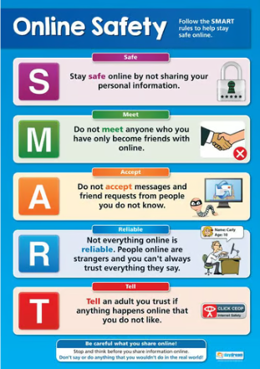
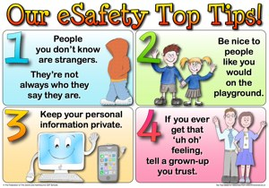
Follow the SMART rules to keep safe online

Slide 4
Website guidance for E-safety
NSPCC- https://www.nspcc.org.uk/keeping-children-safe/online-safety/
GOV.UK- https://www.gov.uk/government/publications/coronavirus-covid-19-keeping-children-safe-online/coronavirus-covid-19-support-for-parents-and-carers-to-keep-children-safe-online
Thinkuknow- https://www.thinkuknow.co.uk/parents/
Young Minds- https://www.youngminds.org.uk/media/nkvbqk20/online-safety-updated-feb-2020.pdf
Internet Matters- https://www.internetmatters.org/schools-esafety/parent-online-support-pack-teachers/

