Slide 1
Crescent and Star: The faith of Islam is symbolized by the Crescent and Star. The Crescent is the early phase of the moon and represents progress. The star signifies illumination with the light of knowledge.

Slide 4
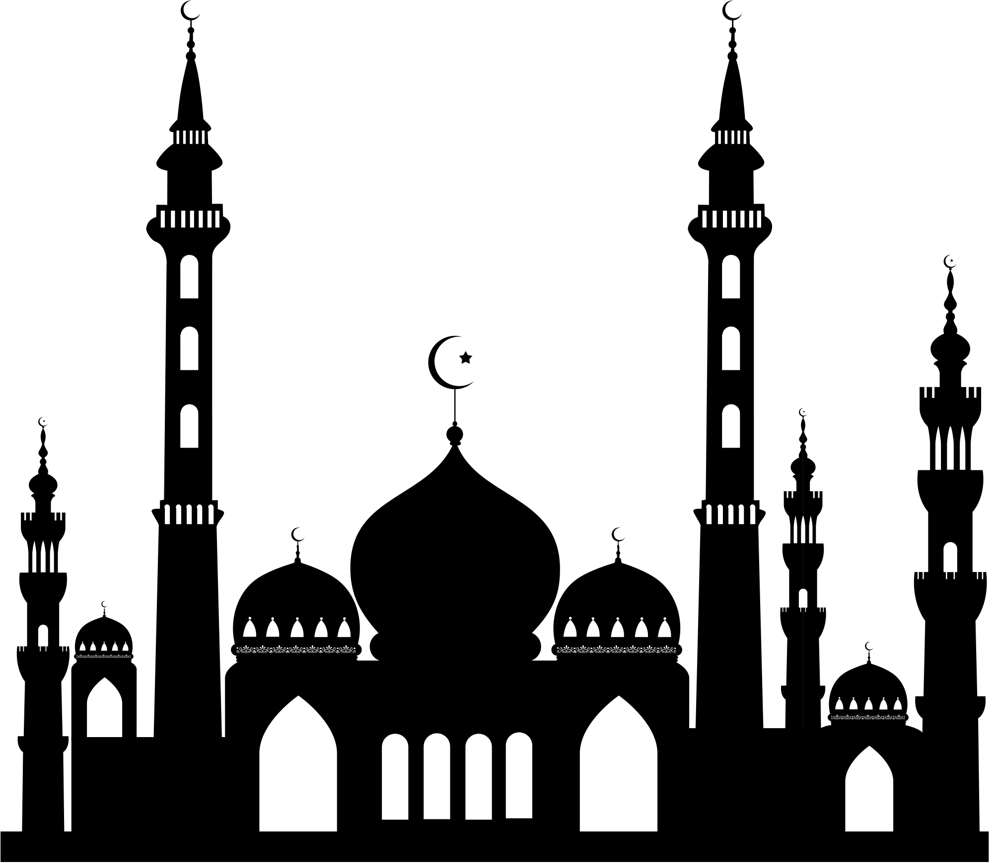
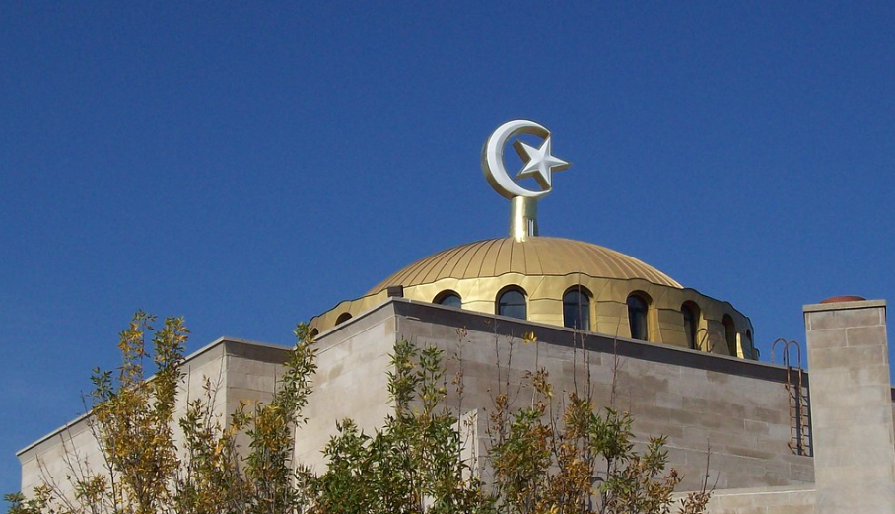
The 5 pointed star represents the 5 important things to Muslims.

Slide 5
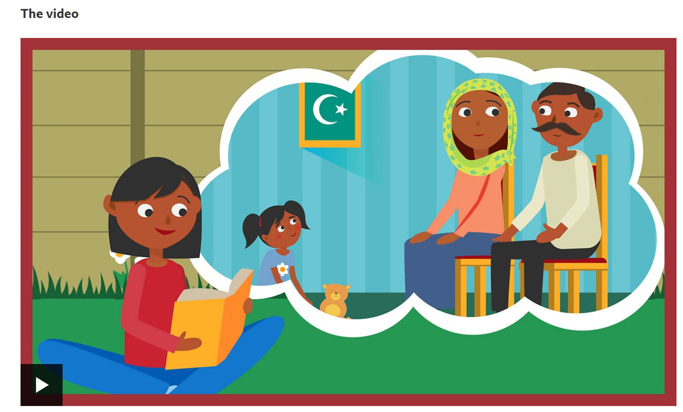
https://www.bbc.co.uk/teach/school-radio/assemblies-five-pillars-of-islam/zvvvp4j

Slide 6
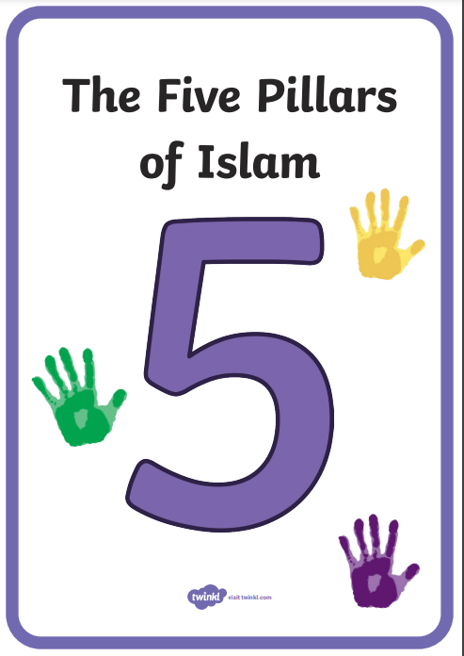
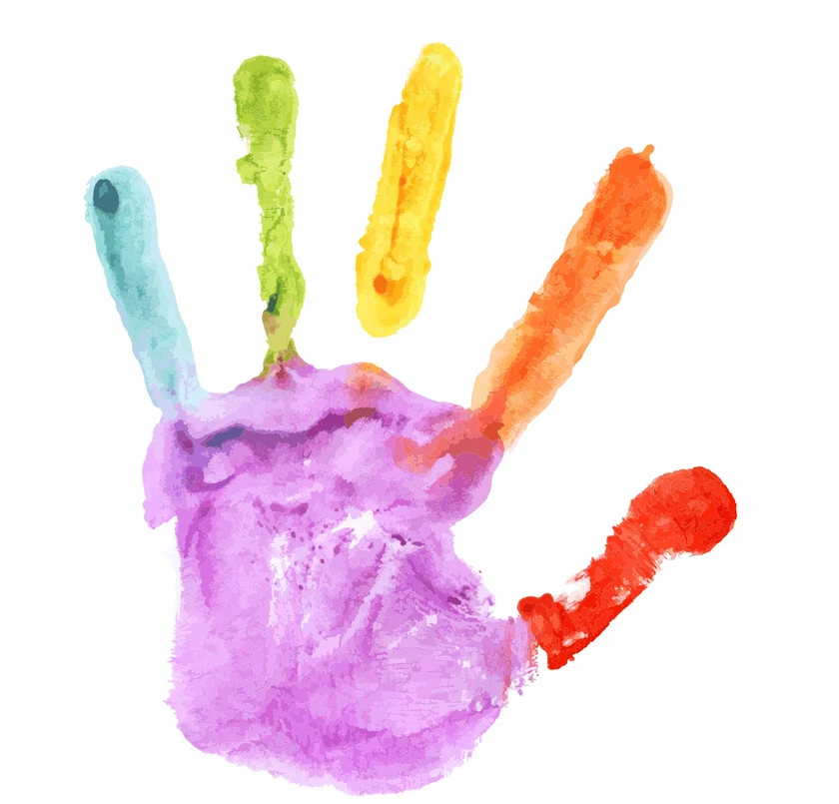

Slide 7
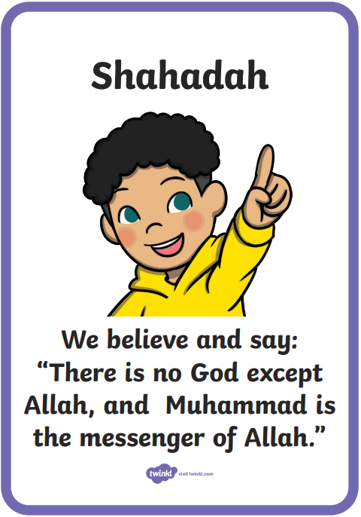
Shahadah (say)
I wonder what you would say? What is an important message to you that you would repeat every day?
Which one of our BRILLIANT expectations could you say out loud every day to help you to be BRILLIANT?

Slide 8
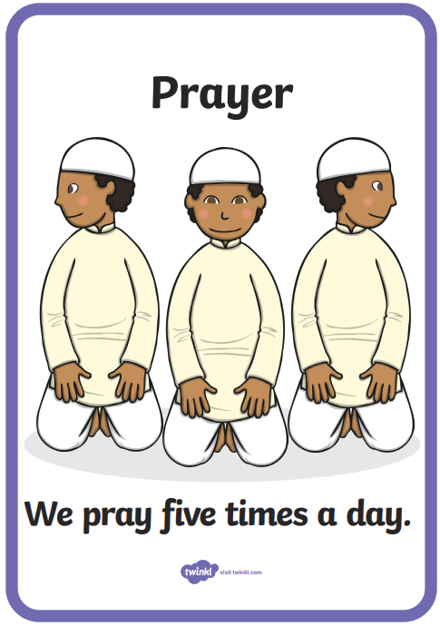
Salah ( prayer)
Do you ever pray or have some special quiet time in your day?
I wonder what you would say THANK YOU, PLEASE and SORRY if you were to pray?

Slide 9
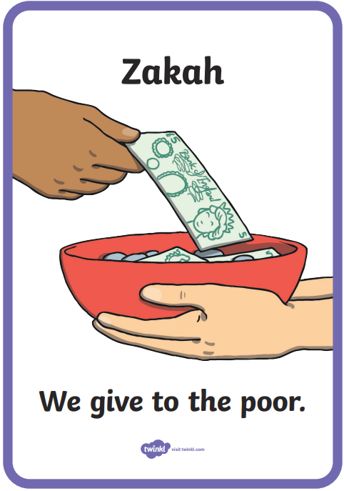
Zakah (give)
What have we been doing at school to support Alfie’s charity DKMS?
Which ice cream will you buy today?

Slide 10
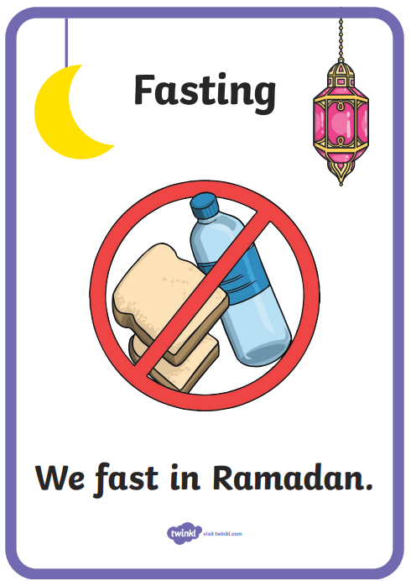
Sawm (fast)
Is there something you could give up doing for a few days? Maybe you could fast playing computer games? Or is there something you could start doing? Maybe you could read every day when you get home from school.

Slide 11
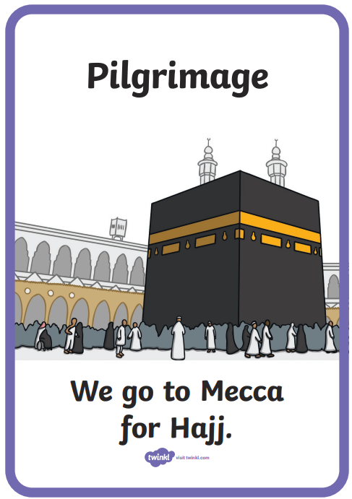
Hajj (go)
Is there a special place that you like to visit with your family? Is there a special place you would LOVE to go and visit?

Slide 12
5 things that are important to Mrs Fothergill
Family (Mr Fothergill, Else, Malcolm)
Friends (Rosie)
Home (Strelley)
Beliefs (Honesty)
My country (Poland)

Slide 13
5 things that are important to Mrs Moore
Family (Mr Moore, Elijah and Jonah)
Friends (Bryony)
Home (Beeston)
Beliefs (Following Jesus’ example)
My country (Isle of Man)

Slide 14
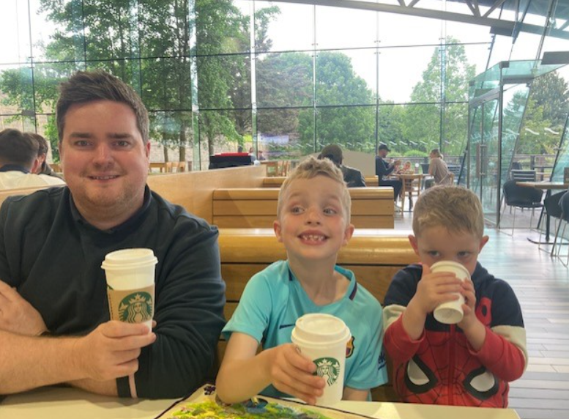
1. Family

Slide 15
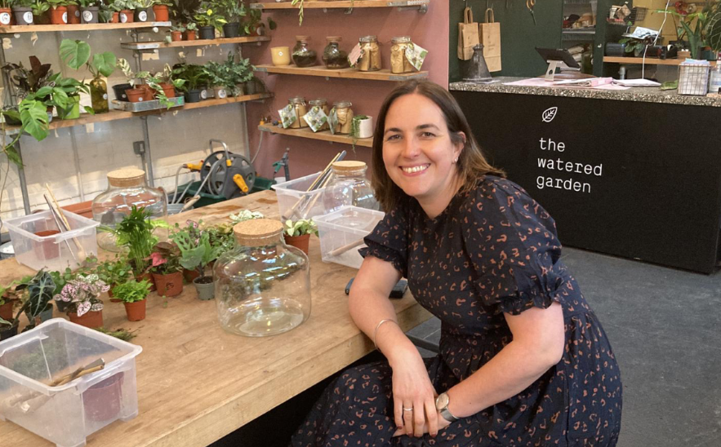
2. Friends

Slide 16
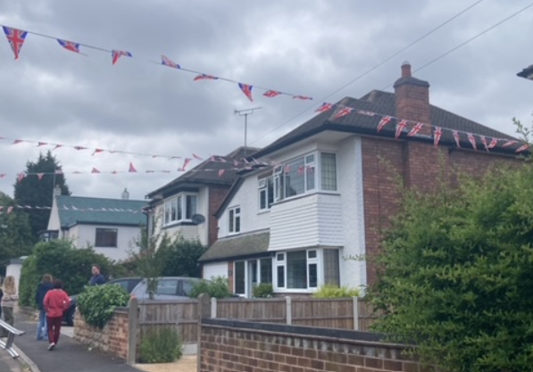
3. Home

Slide 17
4. Beliefs

Slide 18
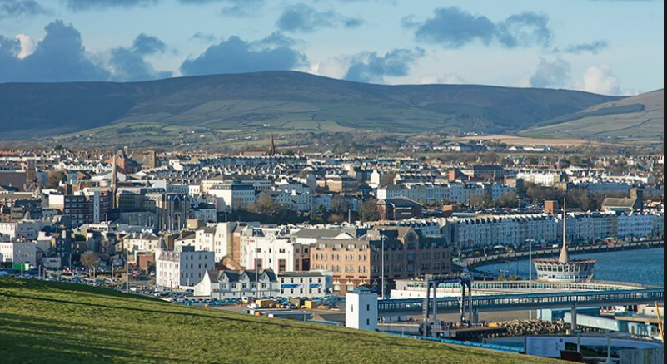
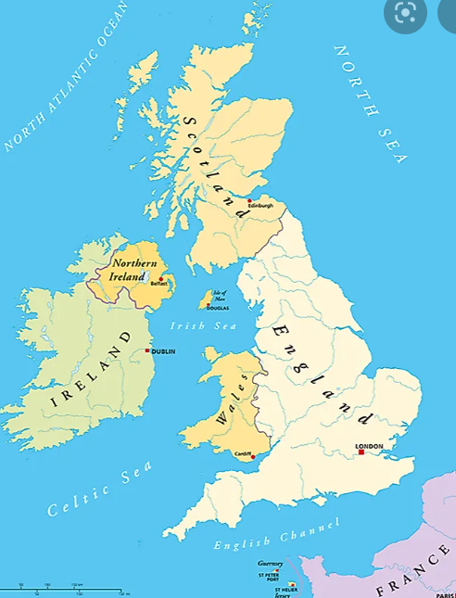
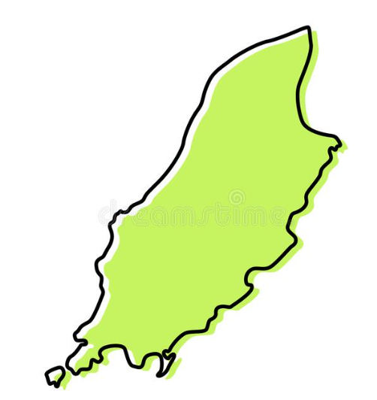
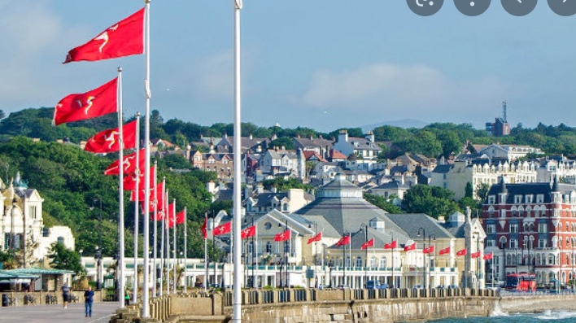
5. Country

Slide 19
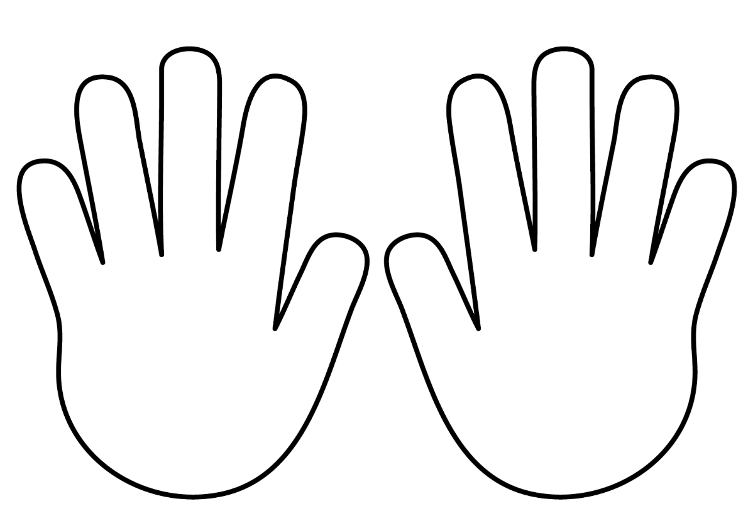
What are the five important things to you?
Write/ draw 5 things important to me! Write or draw on each finger of the handprint! This is an activity that you could do whilst you are exploring the classroom. Maybe you could cut out a hand and chat to your friend about the 5 important things to you.

Slide 21
Children to add their painted hand prints to decorate the large version of the symbol. One symbol made over the day.

Slide 22
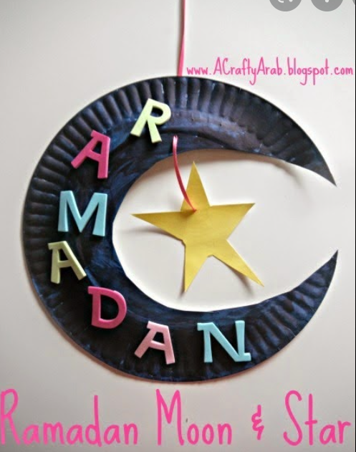
You are going to make a hanging mobile to take home to help you remember the Islamic symbol of the crescent and the star.
I wonder what symbol is important to you?

