Slide 1
Be Brilliant
Banks Road School Assemblies

Slide 2
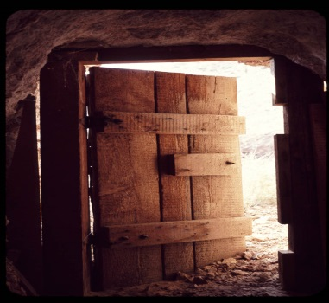
Welcoming
Learning
Music
Focus point
Words
Bible stories
Drama
Video clips
Visual images
Puppets!
Reflecting
Responding
Song
Challenge
School Song
Time of silence
Talk partner
Prayer
Words
Quote

Slide 4
Music to listen to as we WELCOME one another into our collective time together. Welcoming:
Music to reflect on as the children enter the hall. Staff are welcome to use alternative music if this suits the theme of their assembly. In class teachers are able to access a few resources from the website “Ten Pieces” which teach about the composer and why the piece of music has been written. This term we are listening to the songs composed by the “Trailblazers”.

Slide 5
Candles Candles are "lit” at the start of an assembly to help us focus as we collectively come together as a school.

Slide 8
https://www.bbc.co.uk/teach/ten-pieces/ten-pieces-trailblazers/zfpy7nb
Welcoming music: 2021-2022

Slide 9
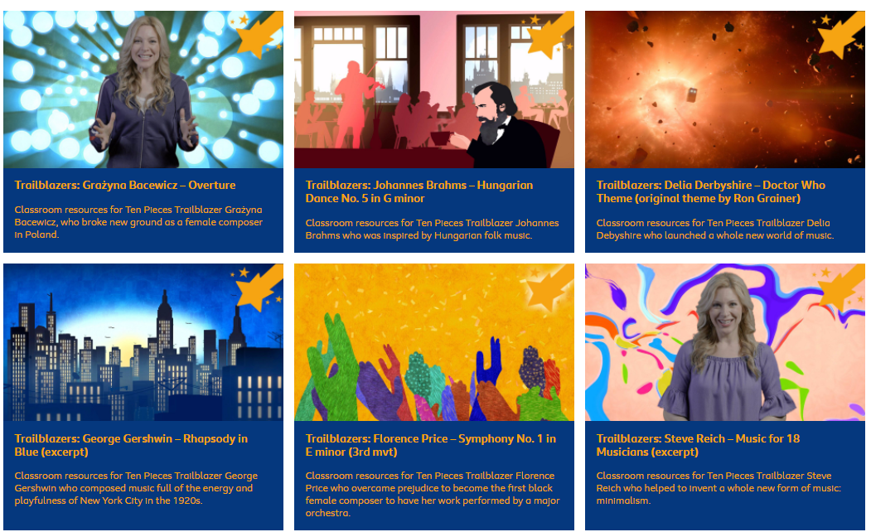

Slide 10
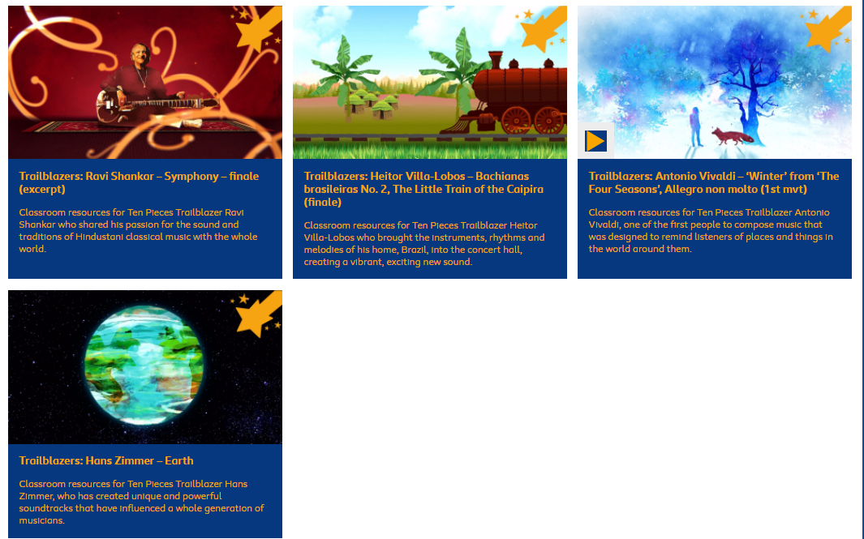

Slide 11
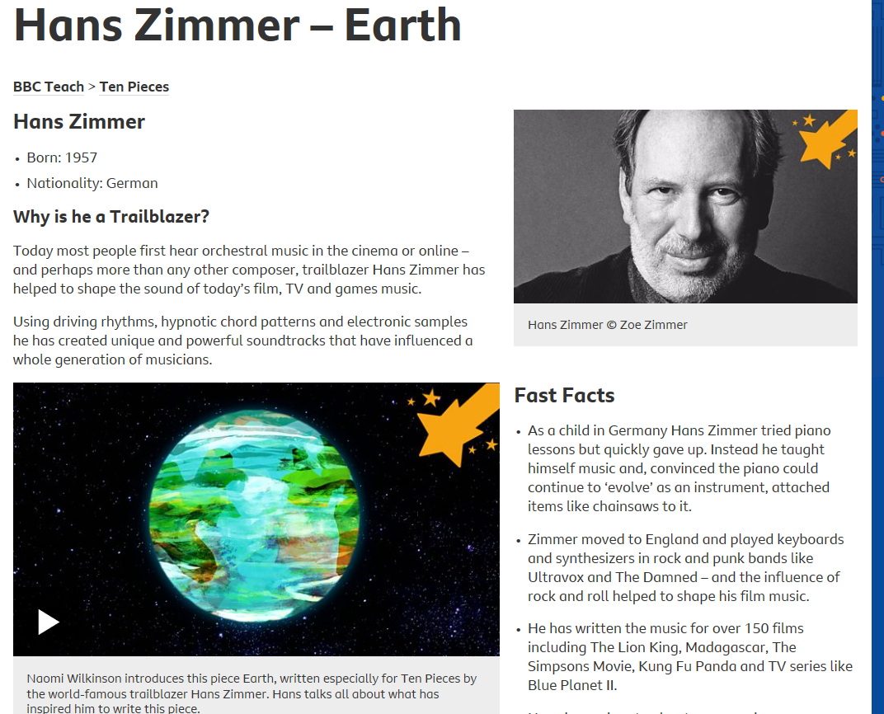
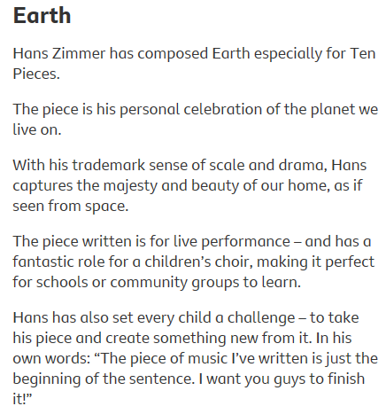
https://www.bbc.co.uk/teach/ten-pieces/classical-music-hans-zimmer-earth/zh4k382

Slide 12
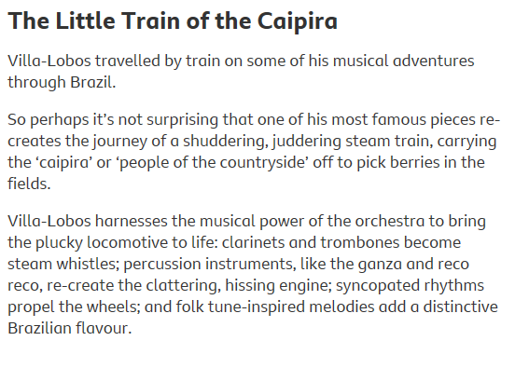
https://www.bbc.co.uk/teach/ten-pieces/classical-music-heitor-villa-lobos/z4nsmfr

Slide 13
Autumn Term Two

Slide 14
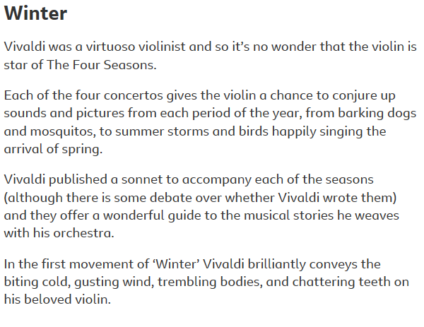
https://www.bbc.co.uk/teach/ten-pieces/classical-music-antonio-vivaldi-winter-from-the-four-seasons/zf98bdm

Slide 15
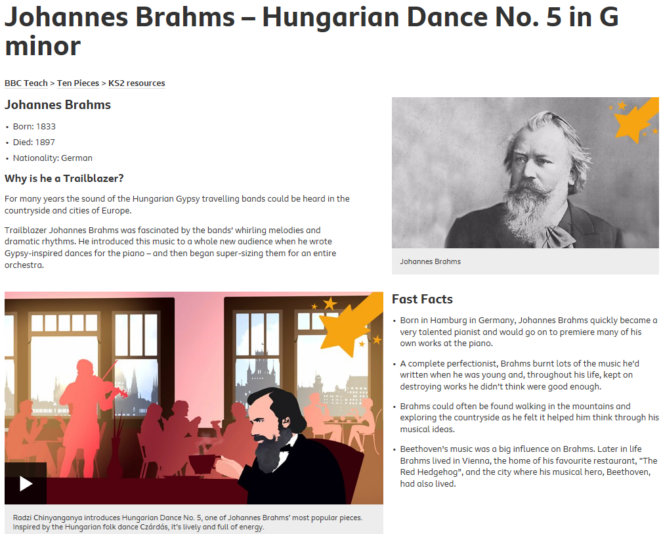
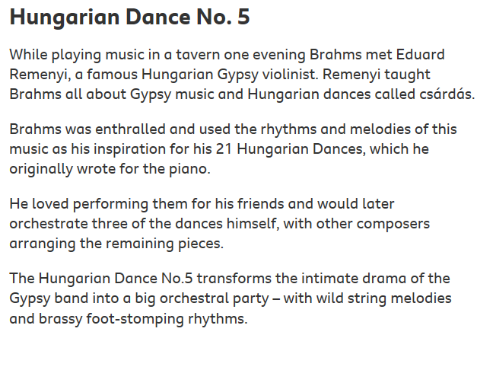
https://www.bbc.co.uk/teach/ten-pieces/classical-music-johannes-brahms-hungarian-dance/zfj4y9q

Slide 16
Spring Term One

Slide 17
https://www.bbc.co.uk/teach/ten-pieces/classical-music-ravi-shankar-symphony-finale/znk8bdm

Slide 18
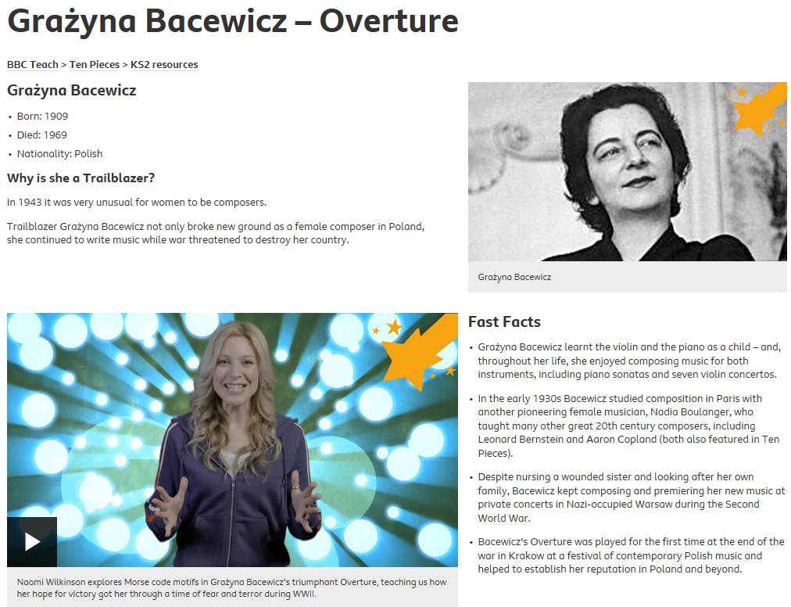
https://www.bbc.co.uk/teach/ten-pieces/classical-music-grazyna-bacewicz-overture/zf2k382

Slide 19
Spring Term Two

Slide 20
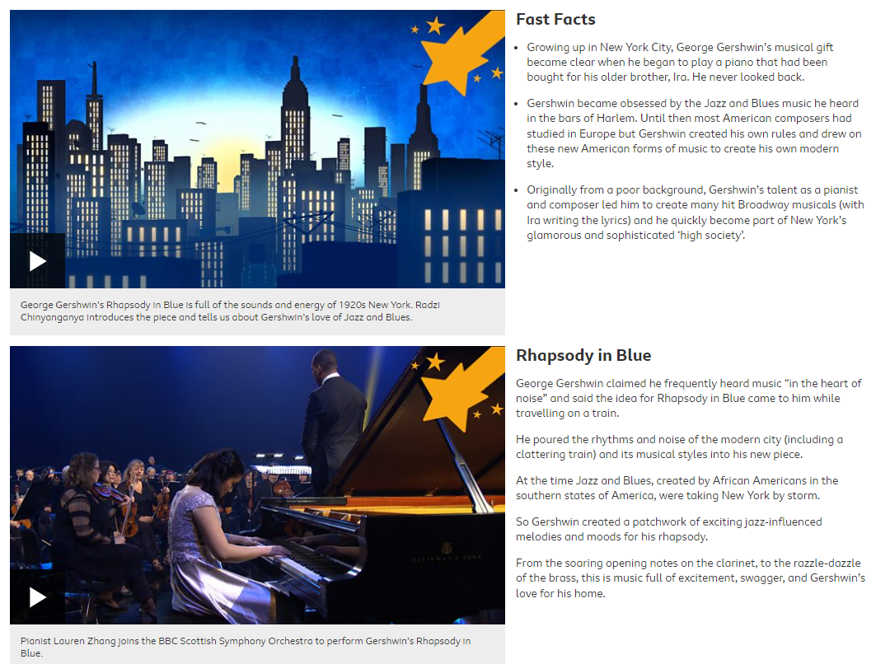
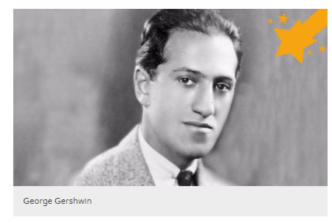
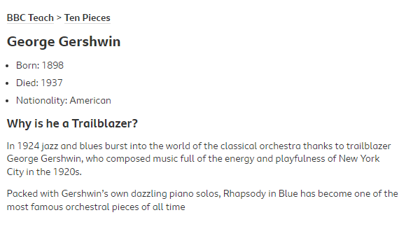
https://www.bbc.co.uk/teach/ten-pieces/classical-music-george-gershwin-rhapsody-in-blue/zkcy6v4

Slide 21
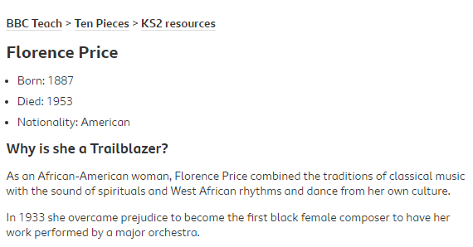
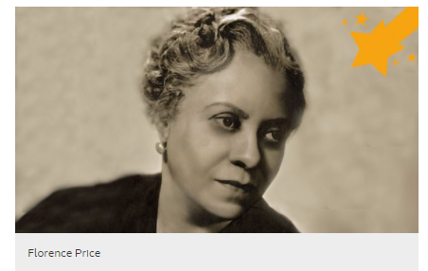
https://www.bbc.co.uk/teach/ten-pieces/classical-music-florence-price-symphony-no1/z48rscw

Slide 22
Summer Term One

Slide 23
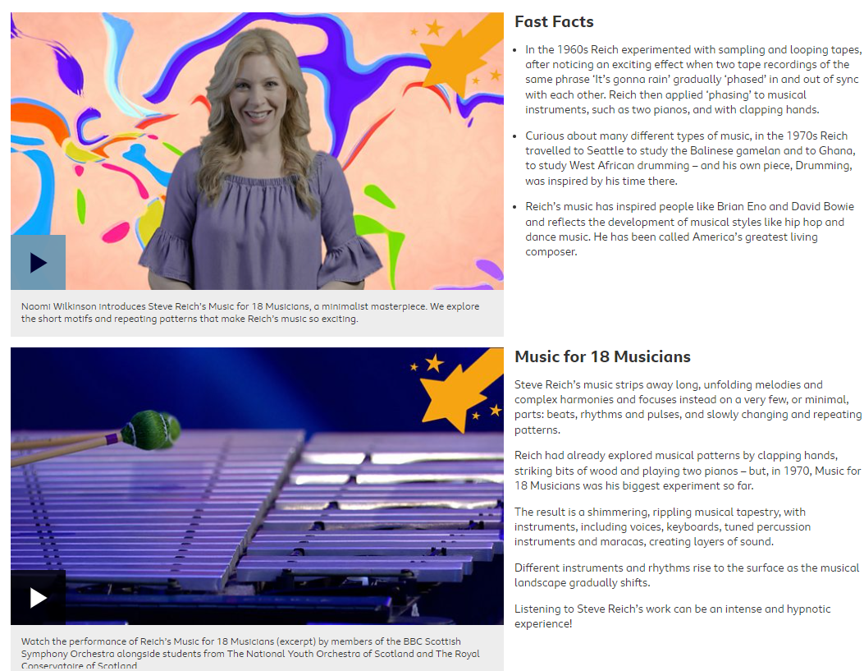
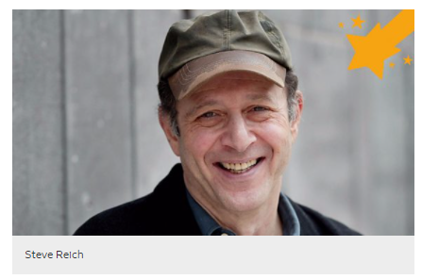
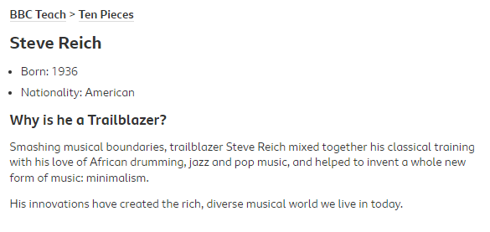
https://www.bbc.co.uk/teach/ten-pieces/classical-music-steve-reich-music-for-18-musicians/zk44y9q

Slide 24
Summer Term Two

Slide 25
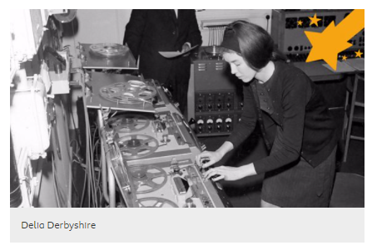
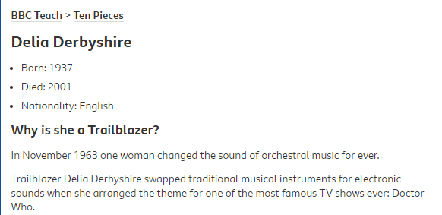
https://www.bbc.co.uk/teach/ten-pieces/classical-music-delia-derbyshire-doctor-who-theme/zfh792p

Slide 27
Learning:
This is the section of the assembly where we are sharing “information” with the school:
this could the lyrics of a new song…focusing on what the lyrics say and what they mean.
this could announcing who the Stars of the Week are and WHY they have been chosen.
this could the part where we discuss something that will be happening in our school like Walk to School Week.
this could be the time where we read a story or read an inspirational quote.

Slide 29
Reflecting:
Reflecting provides an opportunity to be quiet, to reflect and to respond to what this means to ourselves individually and to our school collectively.
Here the children may find it beneficial to sit quietly think about the impact of the meaning of the assembly to them, this could be an opportunity for the children to pray to their God or read through a prayer or an inspirational quote that has personal meaning for them, this could be a time where the children think or discuss the answers to some questions that is relevant to today’s assembly.

Slide 32
T: Thank you
S: Sorry
P: Please

Slide 33
T: Thank you for our school family and the people who inspire us.
S: Sorry when we forget to appreciate our friends.
P: Please help us to enjoy all the new opportunities we are given at Banks Road School.

Slide 35
Responding
Here we provide the children with an opportunity to respond to everything they have heard, thought, watched or experienced during the collective worship time. We want to send the children out “through the hall doors” inspired and challenged. This is a great opportunity to sing the songs they have been learning in singing assembly or uniting their voices to sing the Banks Road song together. You may even set the children a challenge to display one of the BRILLIANT expectations during the week ahead or to read a new book.

Slide 36
We want to be brilliant the best that we can be We want to be brilliant because that’s what Banks Road means We want to be brilliant and reach up for the stars We want to be brilliant even when it’s hard.

Slide 37
Build your confidence, to always try your best
Respect each other, and respect yourself
Inspire those you know, to reach up for their goals
We want to be brilliant, so let’s do that

Slide 38
We want to be brilliant the best that we can be We want to be brilliant because that’s what Banks Road means We want to be brilliant and reach up for the stars We want to be brilliant even when it’s hard.

Slide 39
Listen to others, they’ve got something to say
Learn from all you do, even your mistakes
Improving day to day, in every choice we make
We want to be brilliant, so let’s do that

Slide 40
We want to be brilliant the best that we can be We want to be brilliant because that’s what Banks Road means We want to be brilliant and reach up for the stars We want to be brilliant even when it’s hard.

Slide 41
Achieving all we can, having fun each day
Never, Never give up
Together we are stronger, as we reach up high
We want to be brilliant, so let’s do that

Slide 42
We want to be brilliant the best that we can be We want to be brilliant because that’s what Banks Road means We want to be brilliant and reach up for the stars We want to be brilliant even when it’s hard.

Slide 43
SMSC: Aims and Objectives
To ensure that everyone connected with the school is aware of our values and principles.
To ensure there is a consistent approach to the delivery of SMSC issues through the curriculum and the general life of the school.
To ensure that a pupil’s education is set within a context that is meaningful and appropriate to their age, aptitude and background.
To ensure that pupils know what is expected of them and why.
To give each pupil a range of opportunities to reflect upon and discuss their beliefs, feelings and responses to personal experience.
To enable pupils to develop an understanding of their individual and group identity.
To enable pupils to begin to develop an understanding of their social and cultural environment and an appreciation of the many cultures that now enrich our society.
To give each pupil the opportunity to explore social and moral issues, and develop a sense of social and moral responsibility.

Slide 49
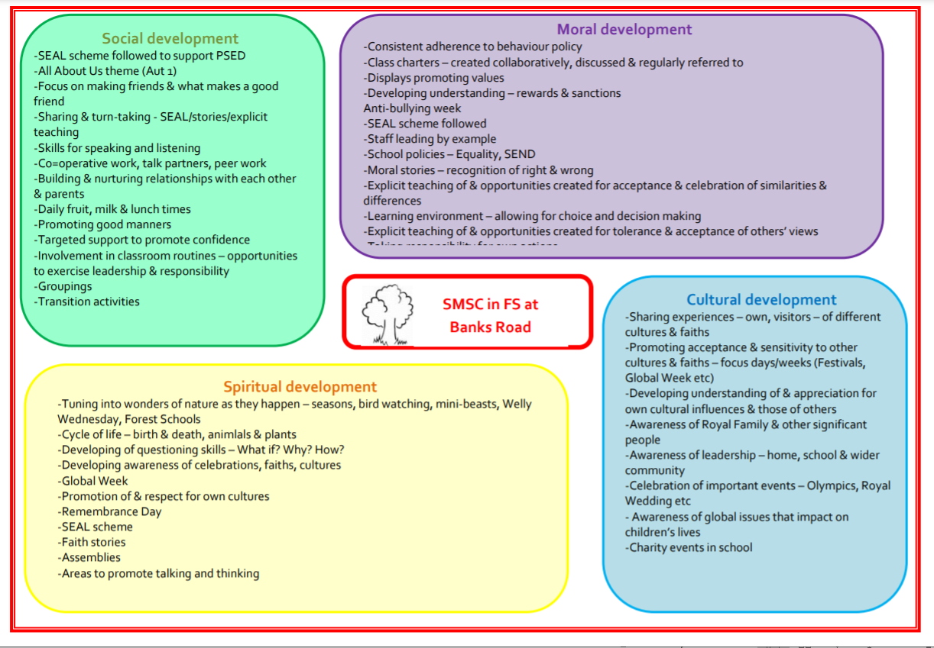

Slide 51
What do ‘British values’ mean?
According DfE, ‘fundamental British values’ comprise:
democracy
the rule of law
individual liberty
mutual respect for and
tolerance of those with different faiths and beliefs, and for those without faith.
Ofsted now pays a lot of attention to SMSC when deciding whether your school is ‘outstanding’, ‘inadequate’ or somewhere in between, and this alongside fundamental British values and Citizenship are highlighted further in the new Education Inspection Framework 2021.

Slide 52
Cultural capital
32. As part of making the judgement about quality of education, inspectors will consider the extent to which schools are equipping pupils with the knowledge and cultural capital they need to succeed in life. Ofsted’s understanding of this knowledge and cultural capital matches the understanding set out in the aims of the national curriculum. It is the essential knowledge that pupils need to be educated citizens, introducing them to the best that has been thought and said, and helping to engender an appreciation of human creativity and achievement.

