Slide 1
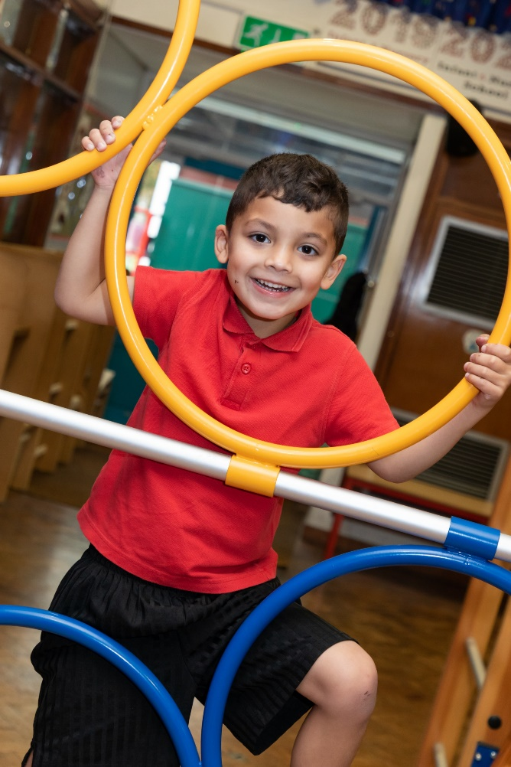
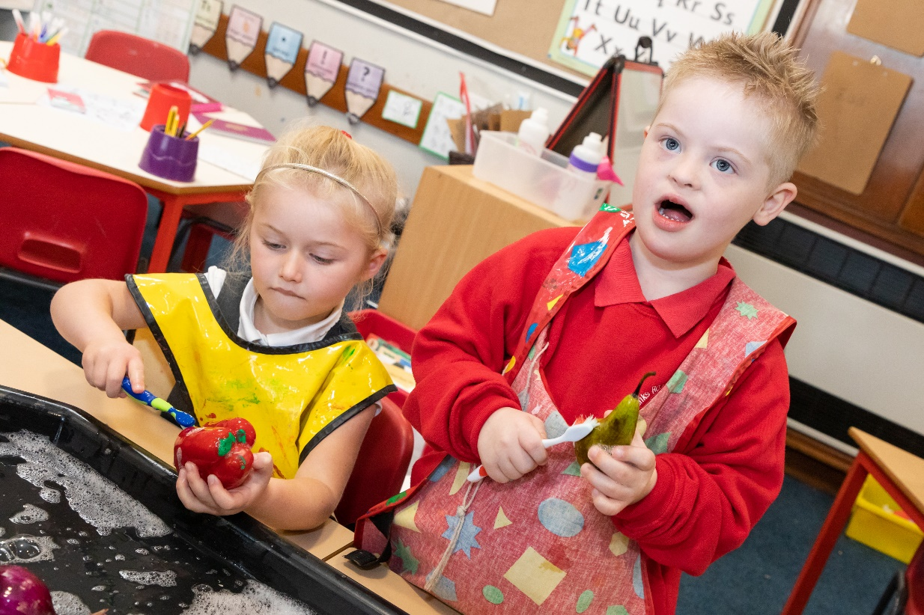
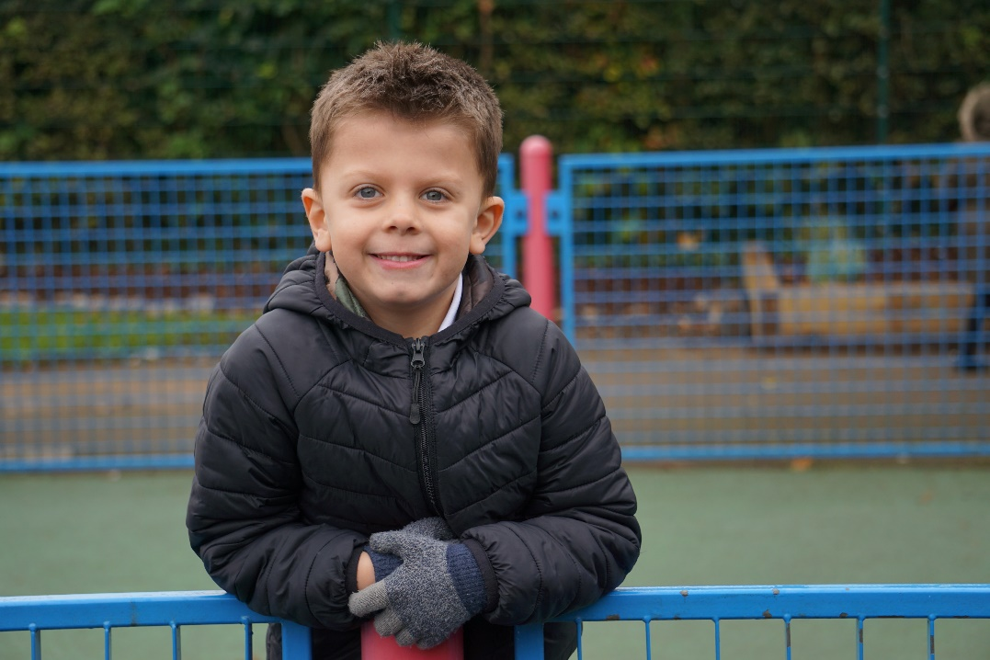
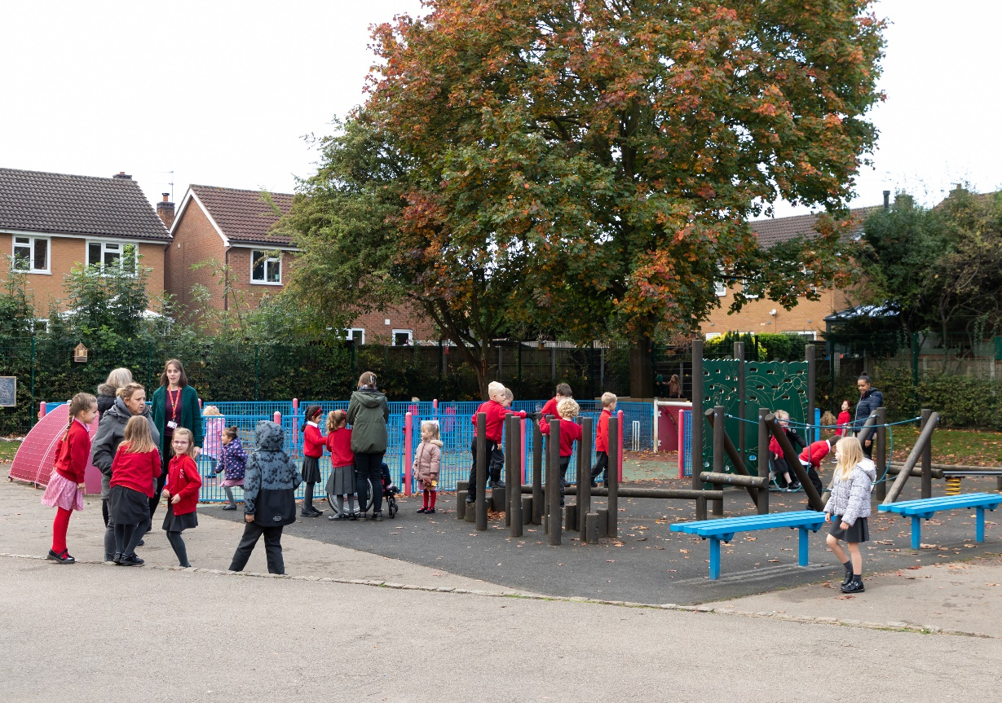
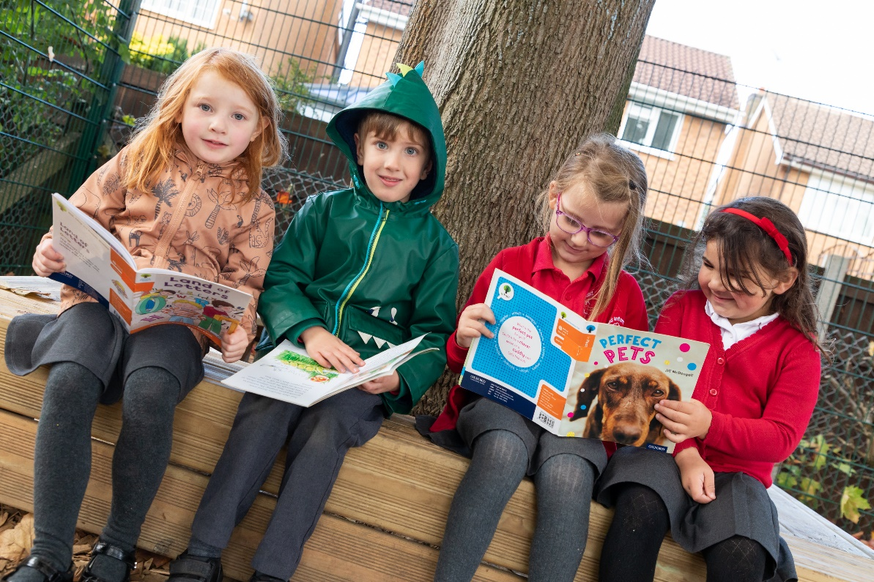

Slide 3
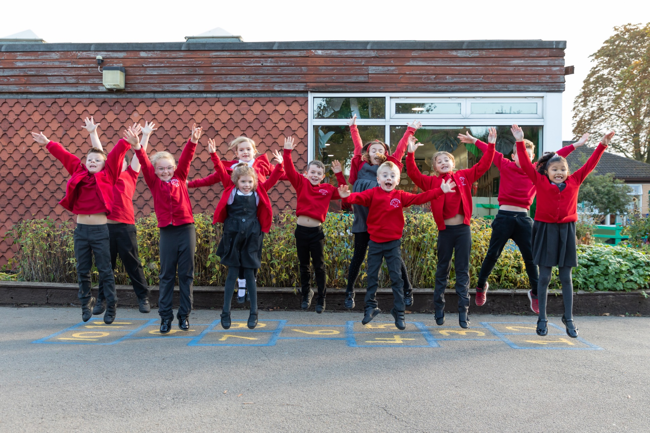
Here we are!
Our school is like a family. We are a home for learning, laughing, caring and trying!
We belong to our families which come from many different cultures, but here at Banks Road everyone is welcome!
We are a lovely school in Toton, Nottingham.

Slide 4
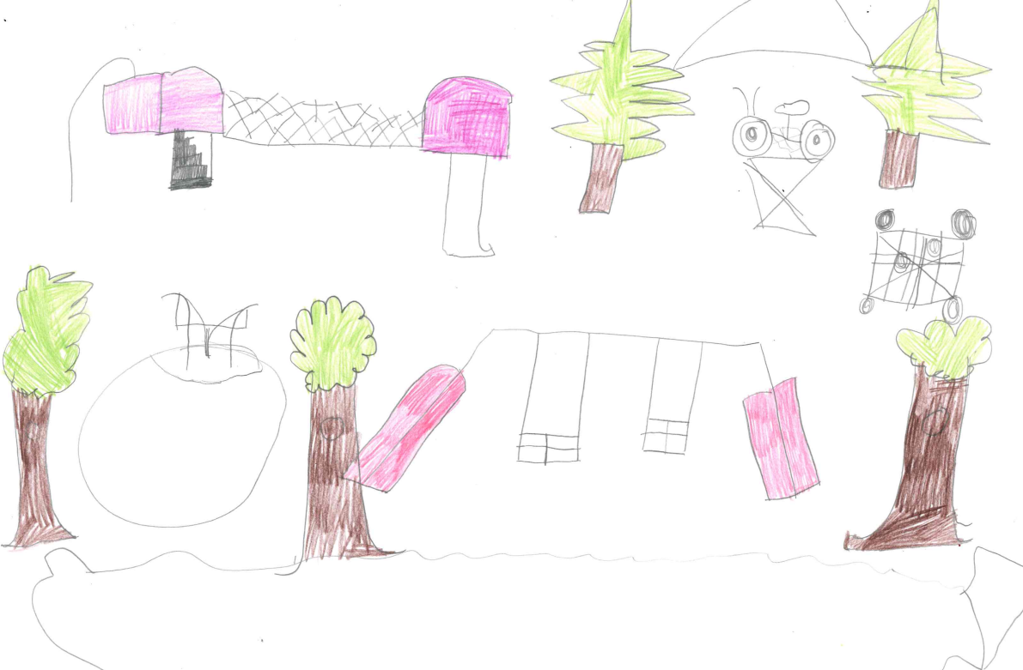
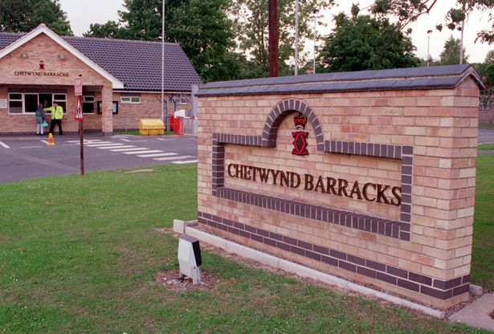
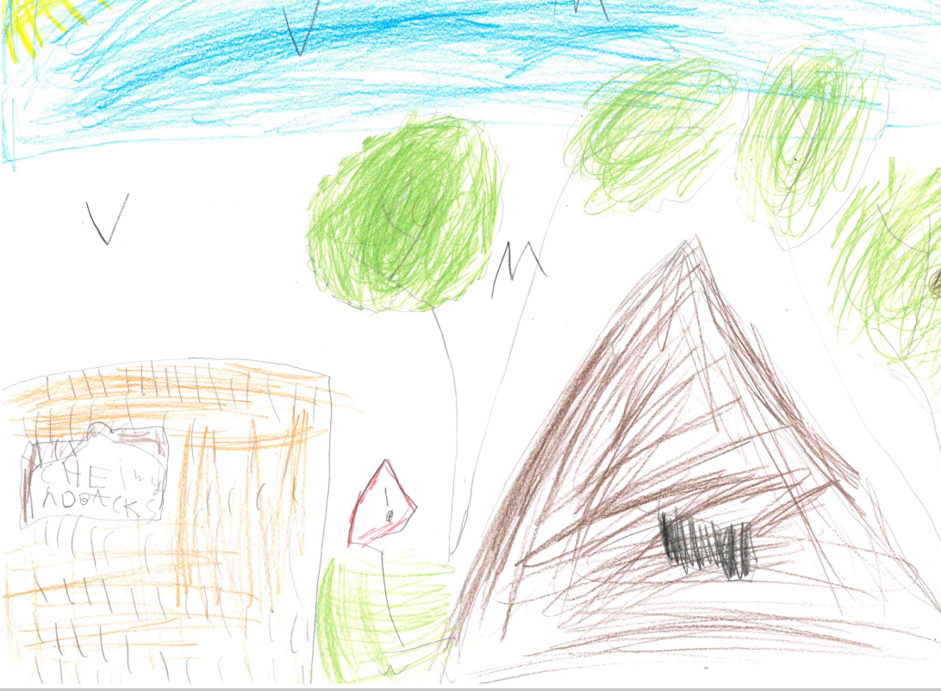
Our local area
We think Banks Road is the best school in Toton because we have walks around our local area and have woods we can go to.
The barracks are a wonderful place. Lots of people who live there have soldiers in their family who protect our country. Some children who come to Banks Road have parents in the armed forces.

Slide 5
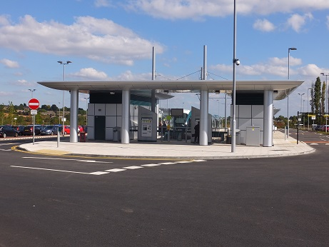
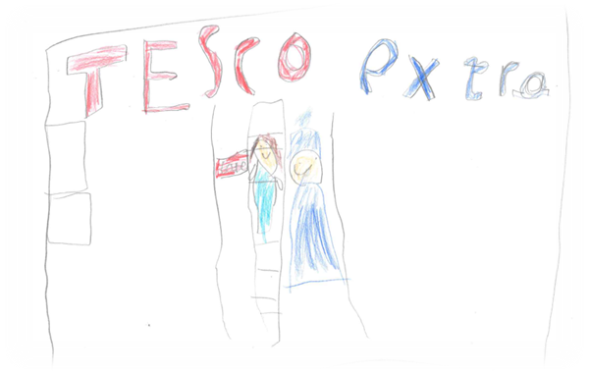
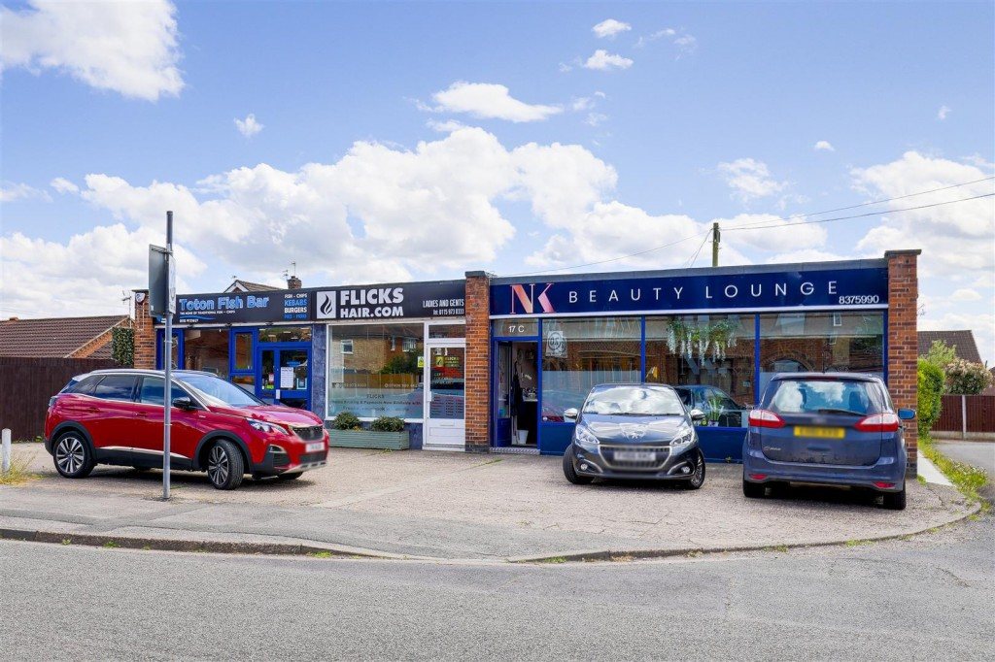
We have lots of shops like Tesco, Premier, a car showroom, and the best fish and chip shop in the world!
There’s a tram stop in Toton that goes to Beeston and Nottingham.

Slide 6
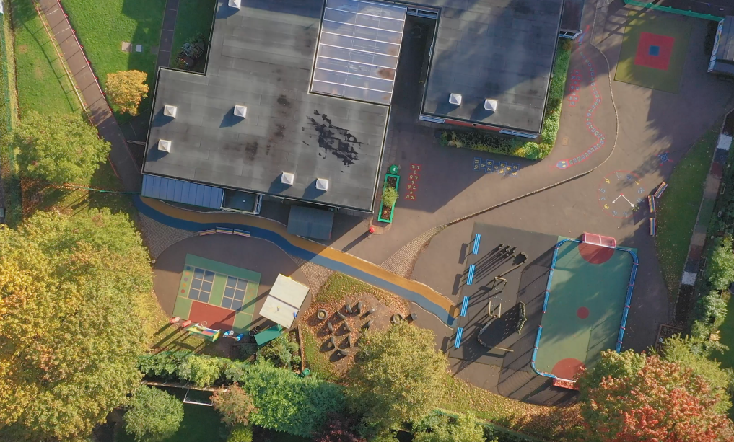
This is us!
Our logo is a tree because we have lots of beautiful trees in our school grounds.
Our classes are named after our trees, we have Acorns – Nursery, Birch – FS2,
Chestnut – FS2, Cherry – Y1, Maple Y1, Oak – Y2 and Willow – Y2

Slide 7
We are BRILLIANT!
Build your confidence
Respect yourself, your school and your community
Inspire yourself and others to succeed
Learn from your mistakes
Listen to others
Improve to be the best that you can be
Achieve and enjoy safely
Never give up
Together we aim high
We have BRILLIANT expectations that we all follow to help us all be the best that we can be! Click below to listen to our Brilliant song!

Slide 8
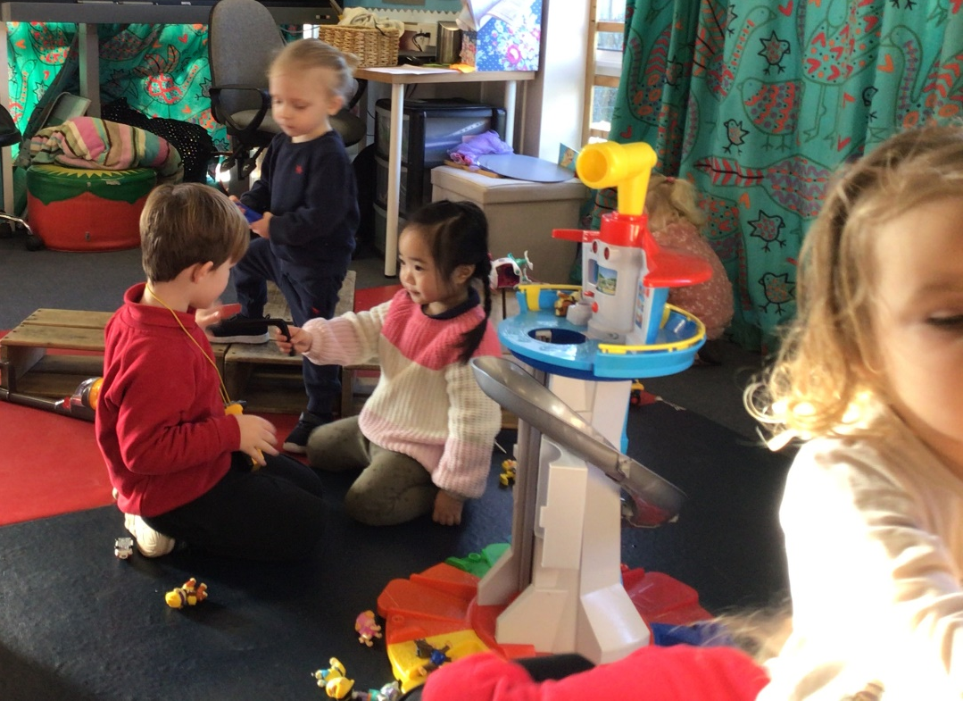
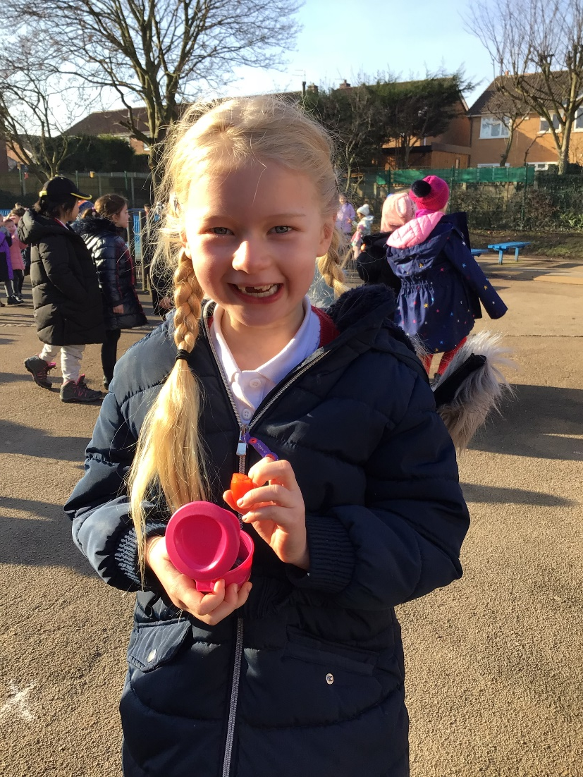
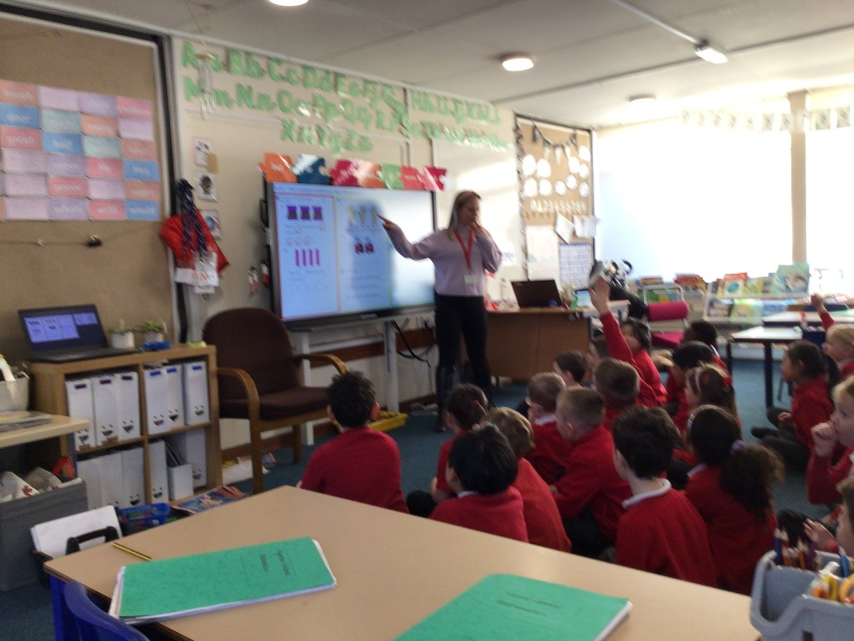
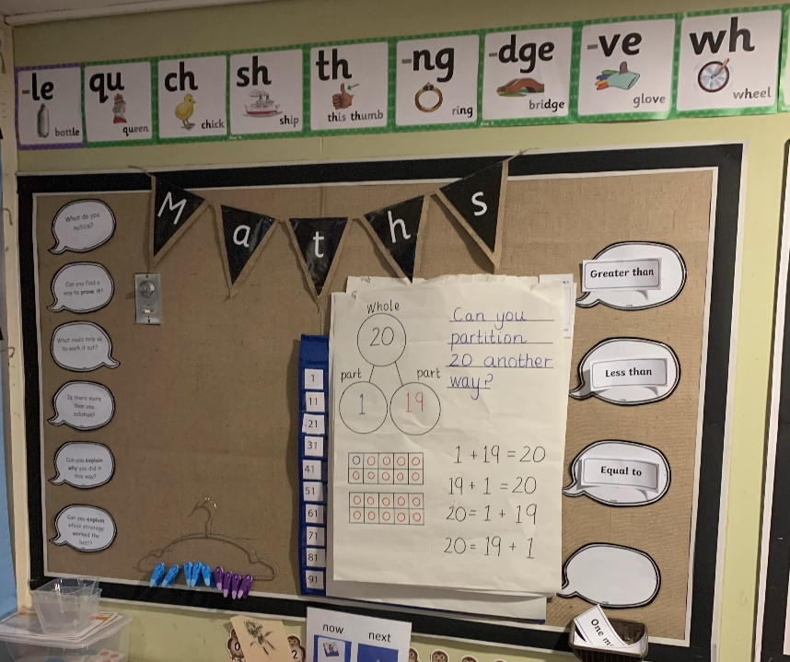
What we notice and wonder!
I like Handwriting, Science and Design and Technology because it’s fun! Ivy H (Year 2)
My favourite things to learn are Phonics, Art and Maths because in Maths you have to write a question and you have to figure it our yourself. Jacob (Year 2)
I like Maths and Art because it’s fun and I love them. Aria (Year 1)
I really like our projects and D&T because we got to do things like Stargazing evening. James (Year 1)
I love Maths, Science, D&T, Art and Handwriting! My favourite is Science because we get to do experiments. Sophie (Year 2)
I love to write exciting stories like Mr Wolf’s Pancakes. Reading helps me to be a good story writer. Ella (Year 1)

Slide 9
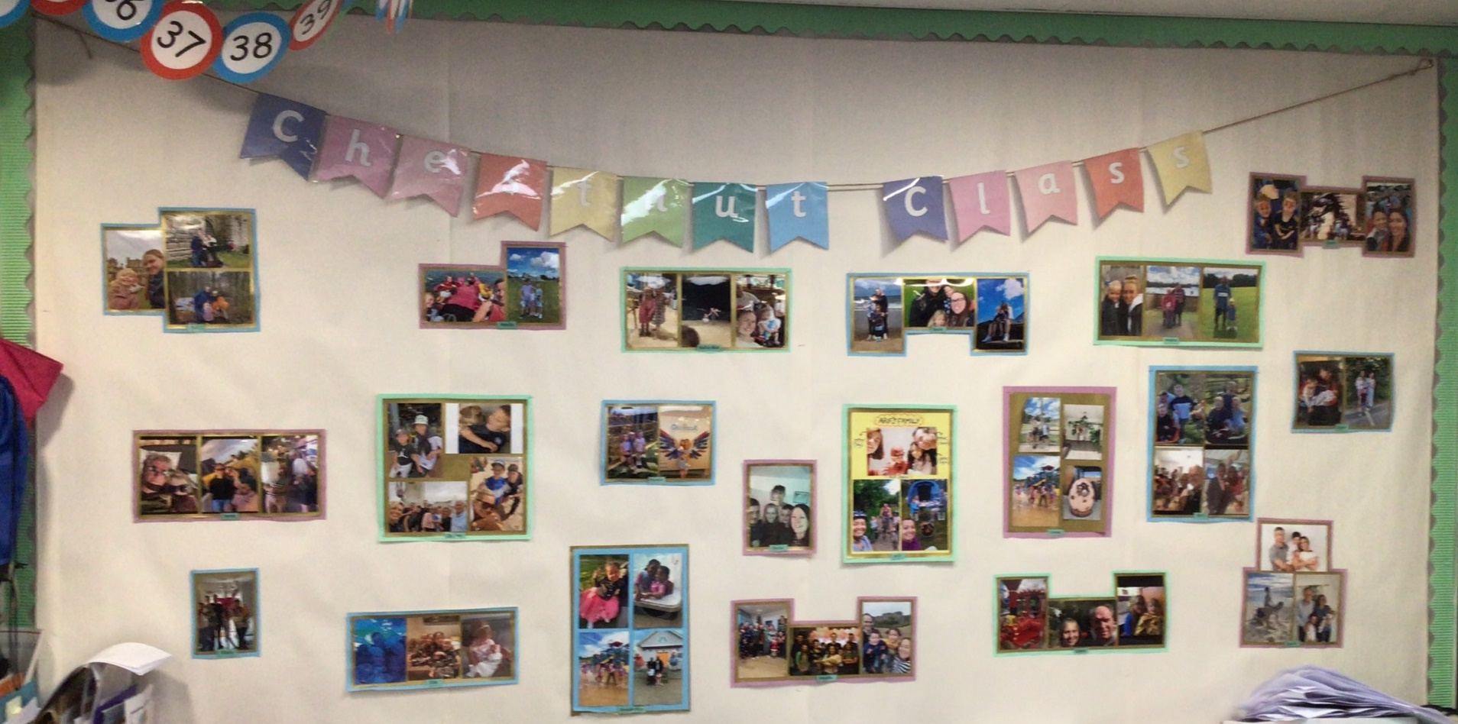
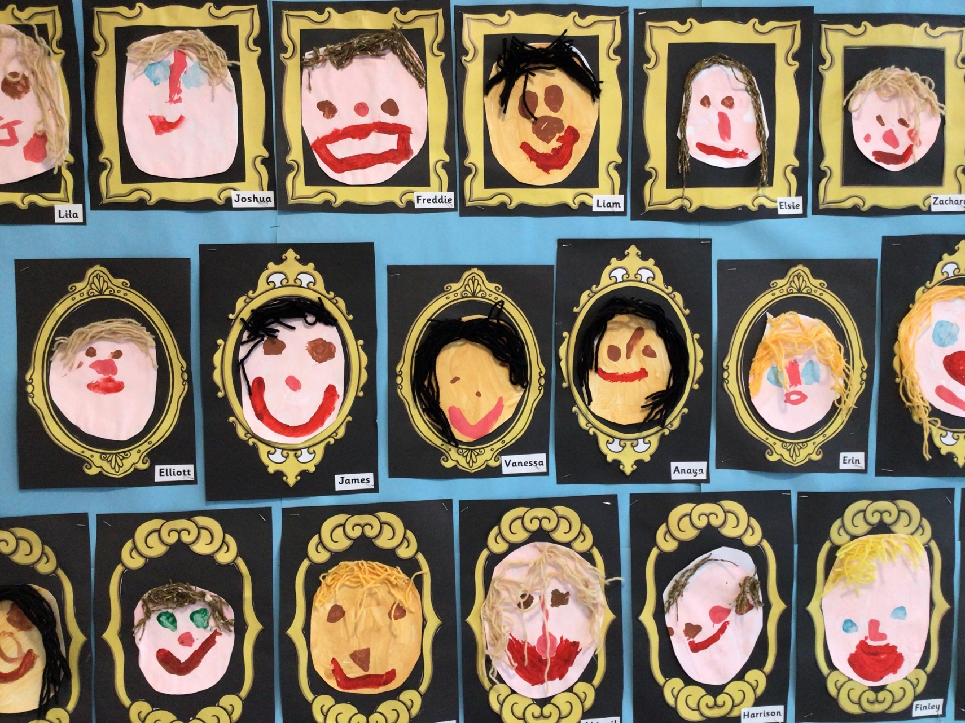
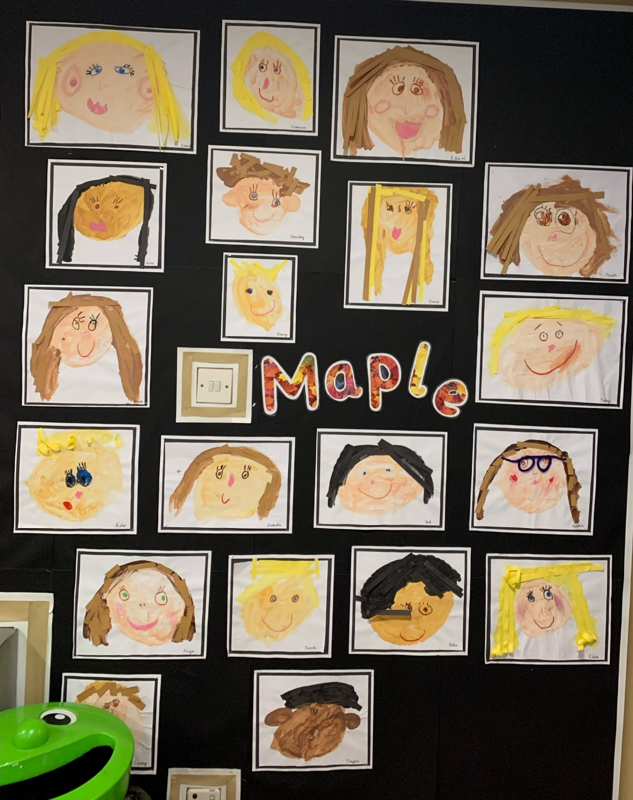
Our school is made up of wonderful children, super staff and fantastic families. These include people from a variety of countries, cultures, experiences and needs. But here at Banks Road compassion and kindness is at the forefront of our work. Every voice matters towards making a beautiful world.

Slide 10
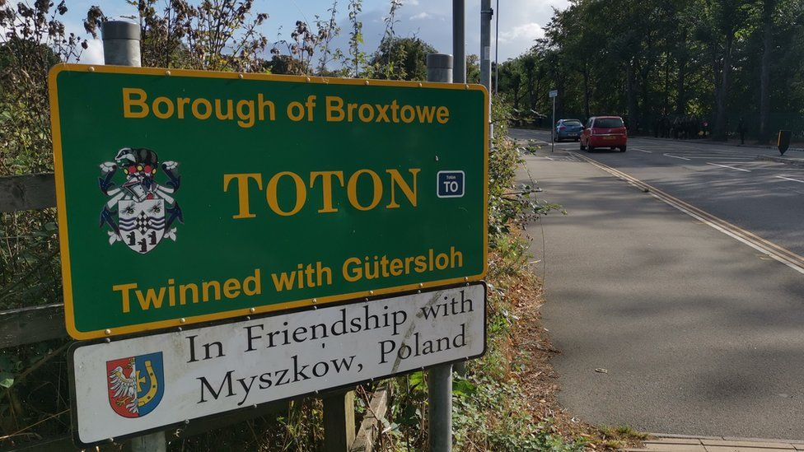
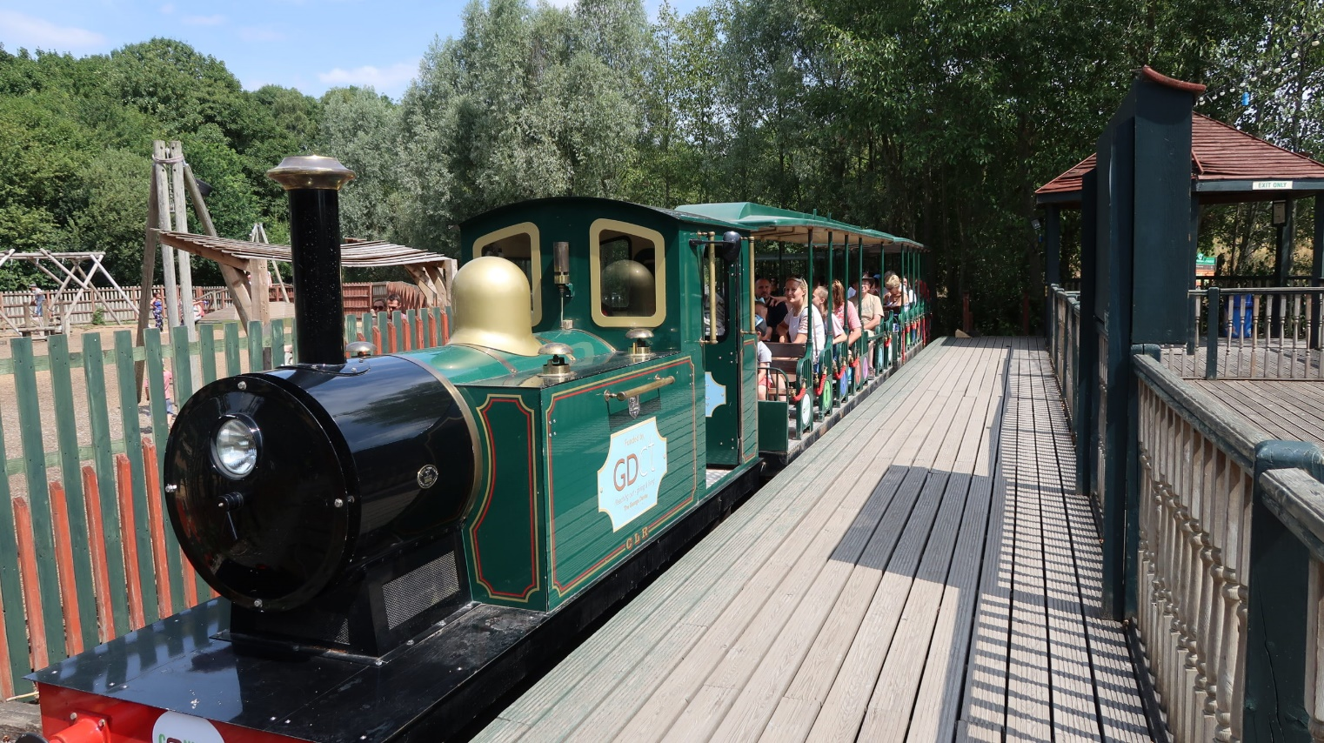
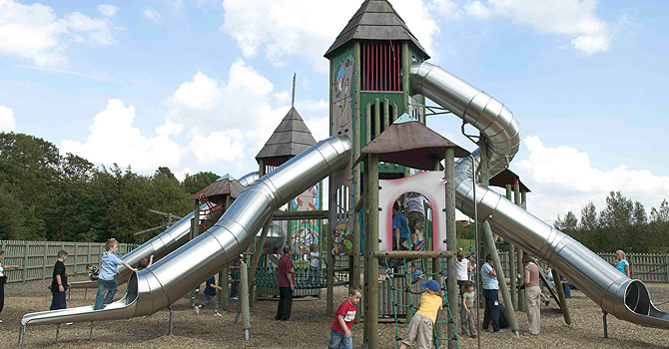
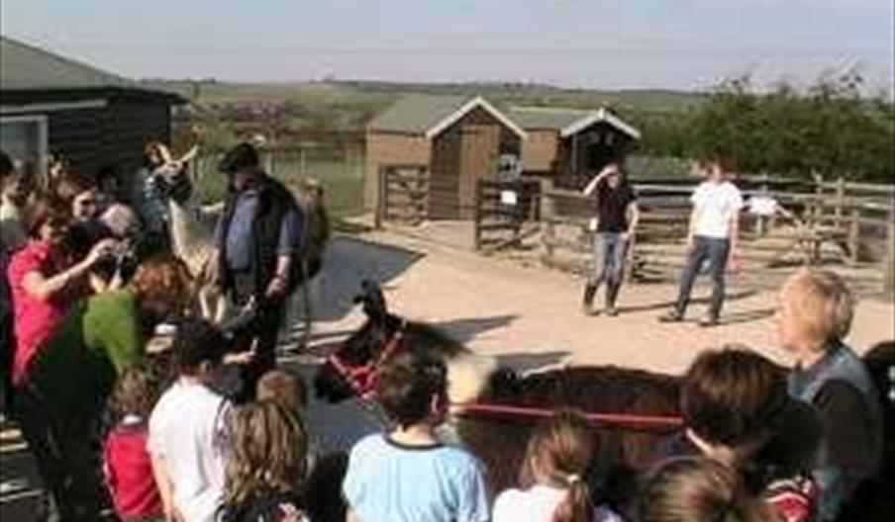
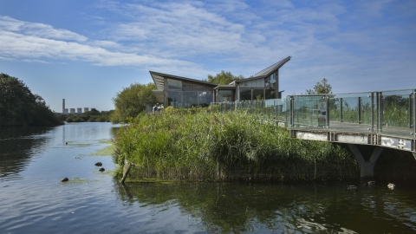
Excellent Expeditions!
Every class gets to go on amazing trips. We use places in our local community like Attenborough Nature Reserve to help us learn about the environment and learn Geography skills. We also get to go to places like Conkers and the Year 2’s have a residential there in Summer!

Slide 11
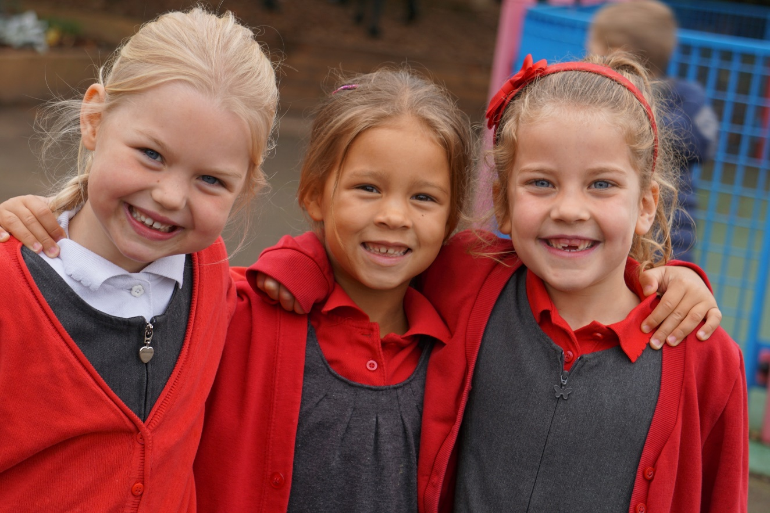
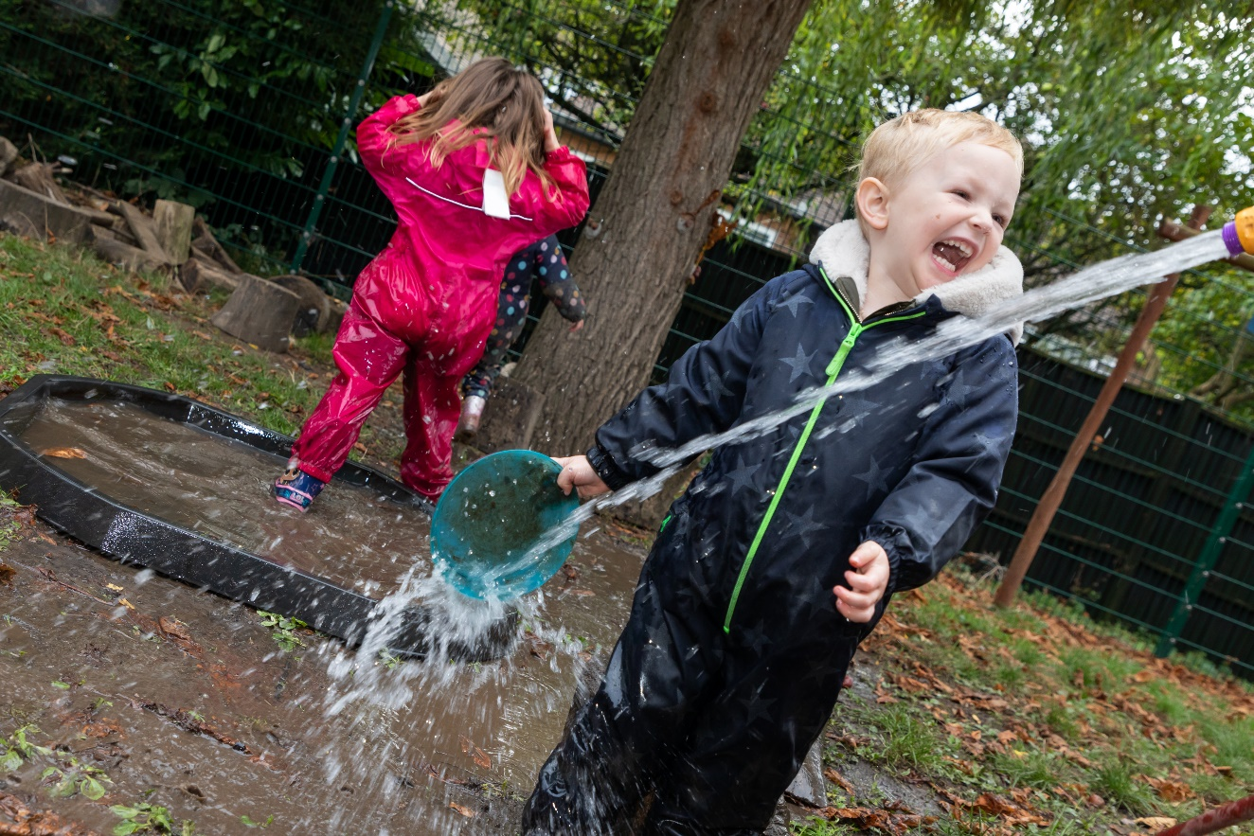
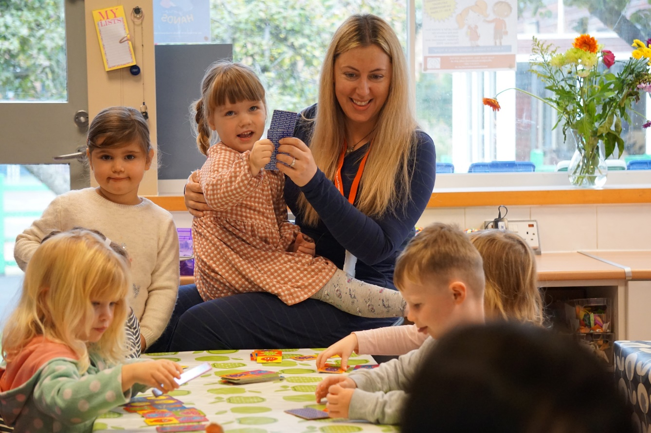
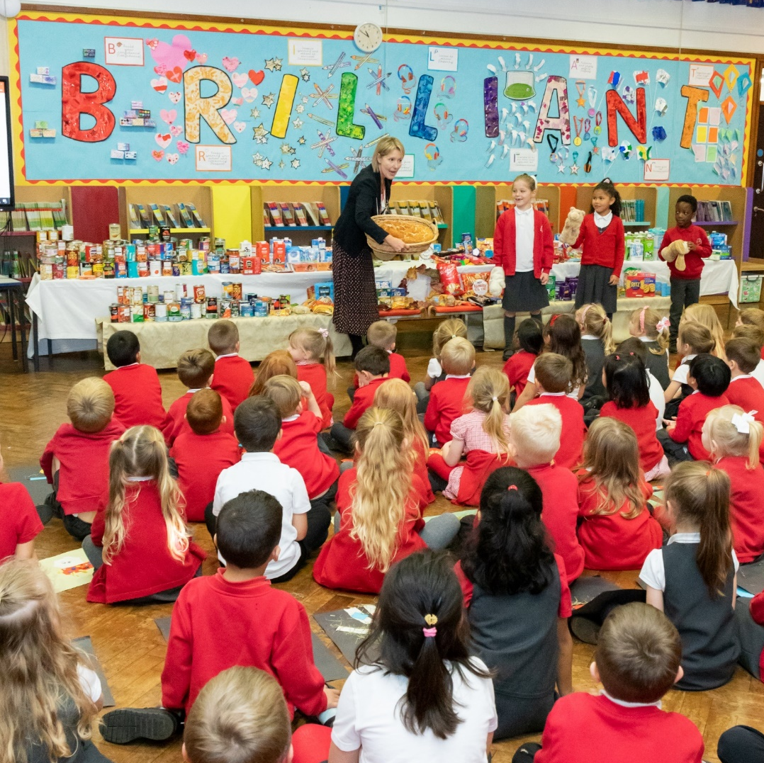
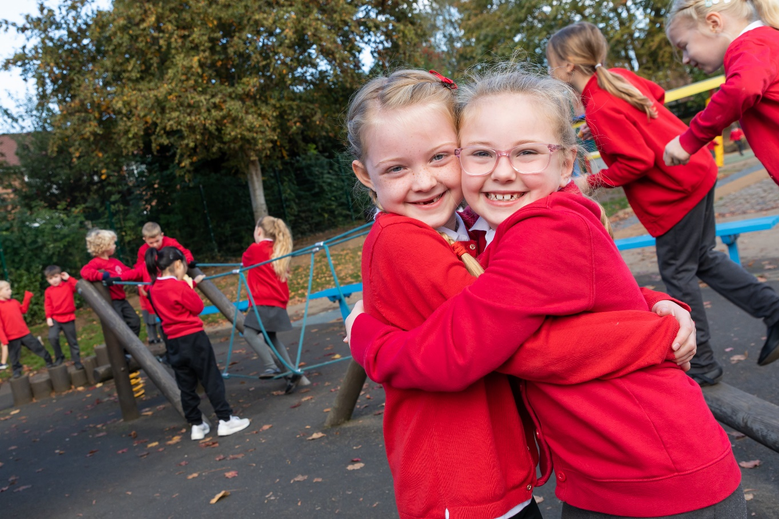
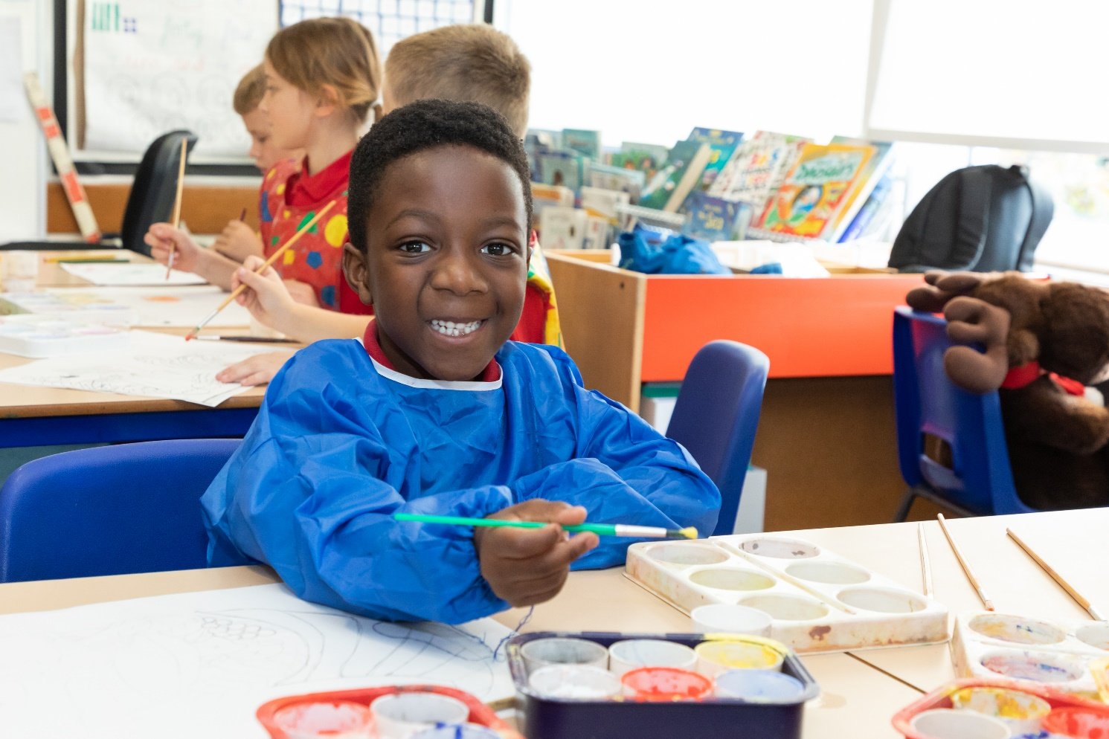
We look forward to you joining our lovely school!
Love all the Banks Road Family x

