Slide 1
Be Brilliant
Values Week 2021- 2022

Slide 3
B
Year One Ambassadors
Build your confidence
(Confidence)

Slide 4
R
Year Two Ambassadors (Oak)
Respect yourself, your school and community
(Respect)

Slide 5
I
Head Teacher Ambassador
Inspire yourself and others to succeed
(Inspiration)

Slide 6
L
Year One Ambassadors
Learn from your mistakes (Resilience)

Slide 7
L
Year One Ambassadors
Listen to others
(Empathy)

Slide 8
I
Year Two Ambassadors (Willow)
Improve to be the best that you can be
(Independence)

Slide 9
A
Year Two Ambassadors (Willow)
Achieve and enjoy, safely
(Safety)

Slide 10
N
Year One Ambassadors
Never give up
(Perseverance)

Slide 11
T
Year Two Ambassadors (Oak)
Together we aim high
(Aspiration)

Slide 12
We want to be brilliant the best that we can be We want to be brilliant because that’s what Banks Road means We want to be brilliant and reach up for the stars We want to be brilliant even when it’s hard.

Slide 13
Build your confidence, to always try your best
Respect each other, and respect yourself
Inspire those you know, to reach up for their goals
We want to be brilliant, so let’s do that

Slide 14
We want to be brilliant the best that we can be We want to be brilliant because that’s what Banks Road means We want to be brilliant and reach up for the stars We want to be brilliant even when it’s hard.

Slide 15
Listen to others, they’ve got something to say
Learn from all you do, even your mistakes
Improving day to day, in every choice we make
We want to be brilliant, so let’s do that

Slide 16
We want to be brilliant the best that we can be We want to be brilliant because that’s what Banks Road means We want to be brilliant and reach up for the stars We want to be brilliant even when it’s hard.

Slide 17
Achieving all we can, having fun each day
Never, Never give up
Together we are stronger, as we reach up high
We want to be brilliant, so let’s do that

Slide 18
We want to be brilliant the best that we can be We want to be brilliant because that’s what Banks Road means We want to be brilliant and reach up for the stars We want to be brilliant even when it’s hard.

Slide 19
Key Questions to explore during Values Week
Who am I?
Who are we?
Where do we live?
How do we all live together?
‘Who lives in my community?’
‘What does it mean to be part of a community?’
‘Where does our school fit in within the community?’
‘What parts do I/ can I play in my community?’

Slide 20
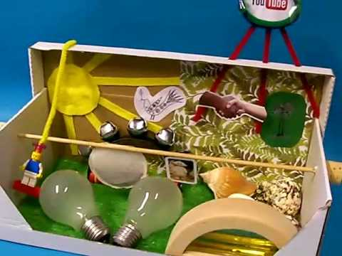
Values (Identity) Box:
All classes to provide an opportunity for children to share about who they are with their peers. This would be done in numerous ways but how about making an Identity Box at home and bringing it in to share with their friends.

Slide 21
Values in Action
Be Brilliant
Monday Assembly: Carole will celebrate our brilliant expectations in action during her assembly…this is an opportunity to celebrate how awesome Banks Road children are.
School Councilors (Brilliant Ambassadors): During Values Week I will be asking for nominations for this years school councilors…I would love their to be some form of a democratic vote but we can discuss this together! The councilors for each year group will also be expected to know what their class ‘brilliant’ letter is and spotting it in action.
During Values week we will ask parents to nominate charities that they’d like the school to promote/ support during the academic year. We will ask for nominations for a local charity and a national charity.

Slide 22
SMSC: Aims and Objectives
To ensure that everyone connected with the school is aware of our values and principles.
To ensure there is a consistent approach to the delivery of SMSC issues through the curriculum and the general life of the school.
To ensure that a pupil’s education is set within a context that is meaningful and appropriate to their age, aptitude and background.
To ensure that pupils know what is expected of them and why.
To give each pupil a range of opportunities to reflect upon and discuss their beliefs, feelings and responses to personal experience.
To enable pupils to develop an understanding of their individual and group identity.
To enable pupils to begin to develop an understanding of their social and cultural environment and an appreciation of the many cultures that now enrich our society.
To give each pupil the opportunity to explore social and moral issues, and develop a sense of social and moral responsibility.

Slide 23
SMSC
What is SMSC?
SMSC stands for spiritual, moral, social and cultural development. All schools in England must show how well their pupils develop in SMSC.
Spiritual
Explore beliefs and experience; respect faiths, feelings and values; enjoy learning about oneself, others and the surrounding world; use imagination and creativity; reflect.
Moral
Recognise right and wrong; respect the law; understand consequences; investigate moral and ethical issues; offer reasoned views.
Social
Use a range of social skills; participate in the local community; appreciate diverse viewpoints; participate, volunteer and cooperate; resolve conflict; engage with the 'British values' of democracy, the rule of law, liberty, respect and tolerance.
Cultural
Appreciate cultural influences; appreciate the role of Britain's parliamentary system; participate in culture opportunities; understand, accept, respect and celebrate diversity.

Slide 25
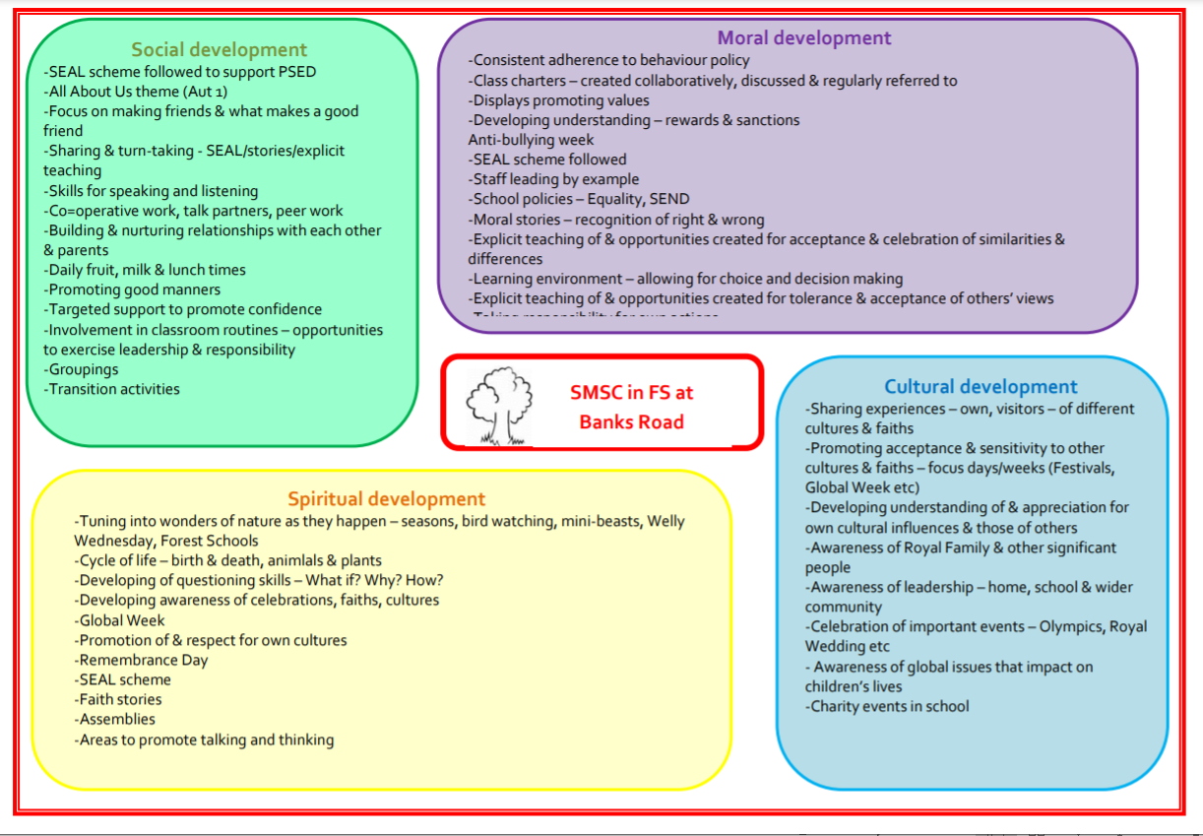

Slide 27
What do ‘British values’ mean?
According DfE, ‘fundamental British values’ comprise:
democracy
the rule of law
individual liberty
mutual respect for and
tolerance of those with different faiths and beliefs, and for those without faith.
Ofsted now pays a lot of attention to SMSC when deciding whether your school is ‘outstanding’, ‘inadequate’ or somewhere in between, and this alongside fundamental British values and Citizenship are highlighted further in the new Education Inspection Framework 2021.

Slide 28
Through their provision of SMSC, schools should: • enable students to develop their self-knowledge, self-esteem and self-confidence; • enable students to distinguish right from wrong and to respect the civil and criminal law of England; • encourage students to accept responsibility for their behaviour, show initiative, and to understand how they can contribute positively to the lives of those living and working in the locality of the school and to society more widely; • enable students to acquire a broad general knowledge of and respect for public institutions and services in England; • further tolerance and harmony between different cultural traditions by enabling students to acquire an appreciation of and respect for their own and other cultures; • encourage respect for other people; and • encourage respect for democracy and support for participation in the democratic processes, including respect for the basis on which the law is made and applied in England. The list below describes the understanding and knowledge expected of pupils as a result of schools promoting fundamental British values. • an understanding of how citizens can influence decision-making through the democratic process; • an appreciation that living under the rule of law protects individual citizens and is essential for their wellbeing and safety; 1 The Prevent strategy 2011: https://www.gov.uk/government/publications/prevent-strategy-2011 5 • an understanding that there is a separation of power between the executive and the judiciary, and that while some public bodies such as the police and the army can be held to account through Parliament, others such as the courts maintain independence; • an understanding that the freedom to choose and hold other faiths and beliefs is protected in law; • an acceptance that other people having different faiths or beliefs to oneself (or having none) should be accepted and tolerated, and should not be the cause of prejudicial or discriminatory behaviour; and • an understanding of the importance of identifying and combatting discrimination. It is not necessary for schools or individuals to ‘promote’ teachings, beliefs or opinions that conflict with their own, but nor is it acceptable for schools to promote discrimination against people or groups on the basis of their belief, opinion or background. Examples of actions that a school can take The following is not designed to be exhaustive, but provides a list of different actions that schools can take, such as: • include in suitable parts of the curriculum, as appropriate for the age of pupils, material on the strengths, advantages and disadvantages of democracy, and how democracy and the law works in Britain, in contrast to other forms of government in other countries; • ensure that all pupils within the school have a voice that is listened to, and demonstrate how democracy works by actively promoting democratic processes such as a school council whose members are voted for by the pupils; • use opportunities such as general or local elections to hold mock elections to promote fundamental British values and provide pupils with the opportunity to learn how to argue and defend points of view; • use teaching resources from a wide variety of sources to help pupils understand a range of faiths, and • consider the role of extra-curricular activity, including any run directly by pupils, in promoting fundamental British values.

Slide 29
Cultural capital
32. As part of making the judgement about quality of education, inspectors will consider the extent to which schools are equipping pupils with the knowledge and cultural capital they need to succeed in life. Ofsted’s understanding of this knowledge and cultural capital matches the understanding set out in the aims of the national curriculum. It is the essential knowledge that pupils need to be educated citizens, introducing them to the best that has been thought and said, and helping to engender an appreciation of human creativity and achievement.

