Slide 1
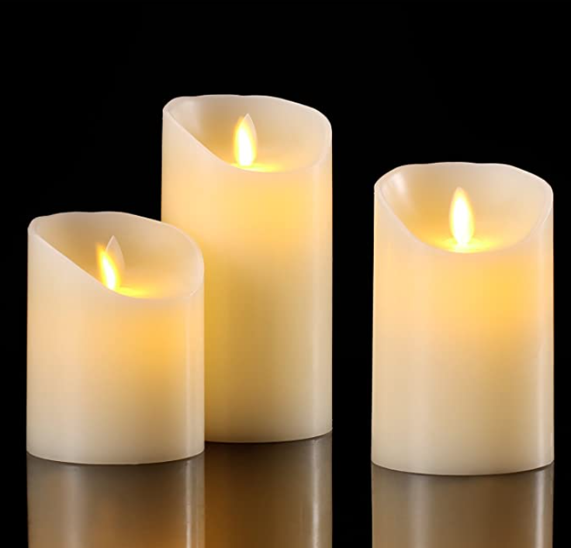

Slide 2
Be Brilliant

Slide 3
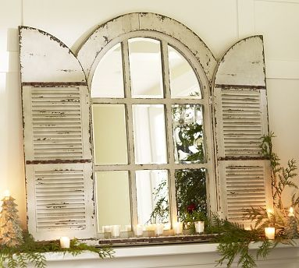

Slide 4
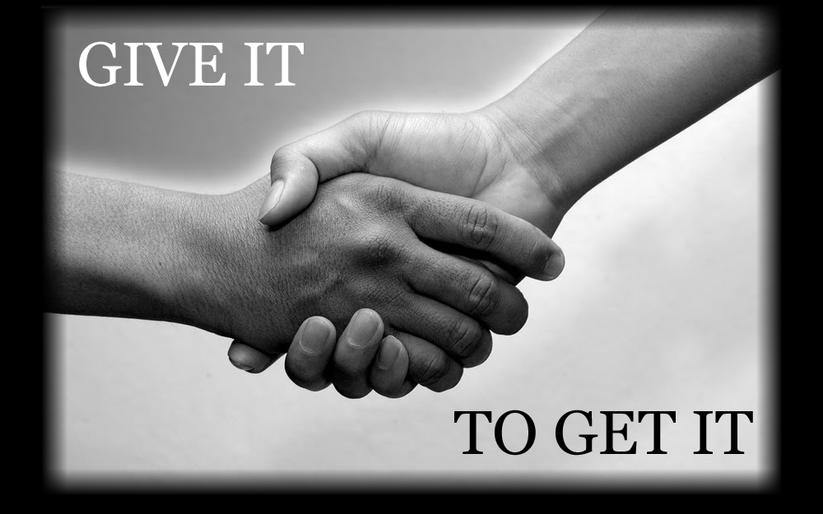
Respect
Banks Road Infant and Nursery School
Banks Road Infant and Nursery School

Slide 5
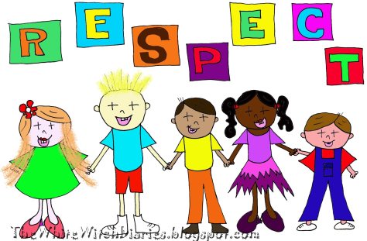
What is respect?
How you treat others
Being thoughtful about peoples feelings
Looking out for other people, property and the environment.
Banks Road Infant and Nursery School

Slide 6
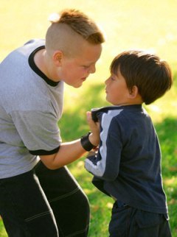
How would you feel
If someone shouted at you?
If someone hit you?
If someone called you names?
If someone took your stuff?
Banks Road Infant and Nursery School

Slide 7
Banks Road Infant and Nursery School
Treat other people how YOU
would like to be treated.
Help people who need it
Listen to your friends
Hold open a door for someone
Smile at someone you don’t normally speak to
Ask someone to join you on the playground

Slide 8
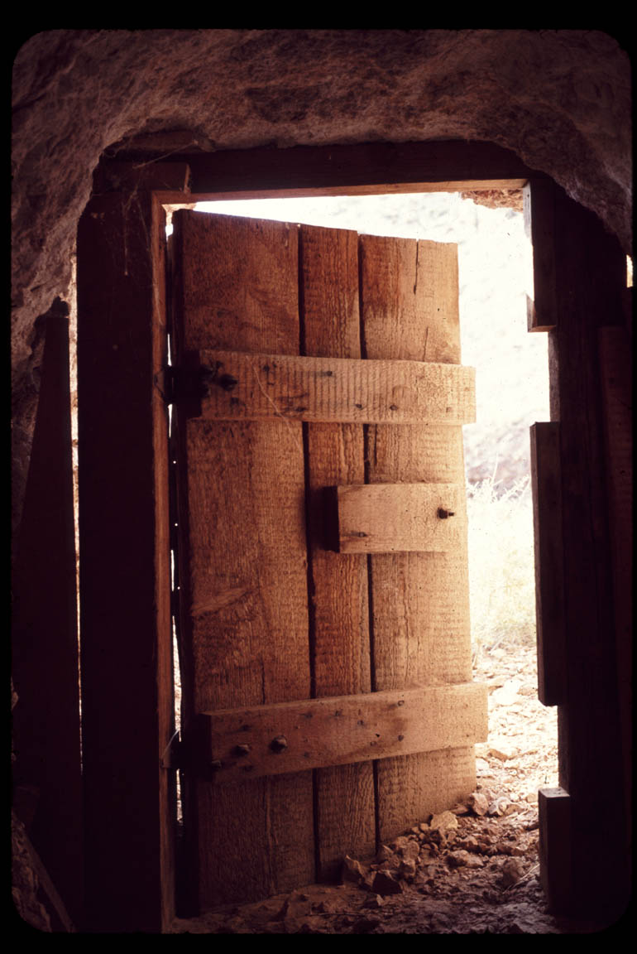
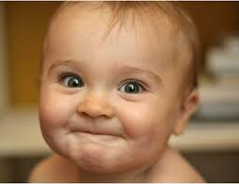
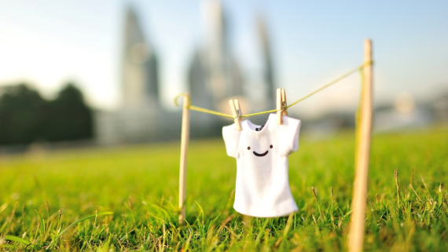
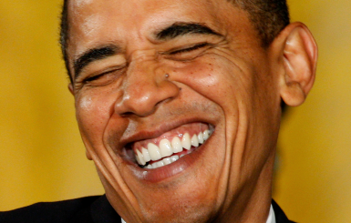
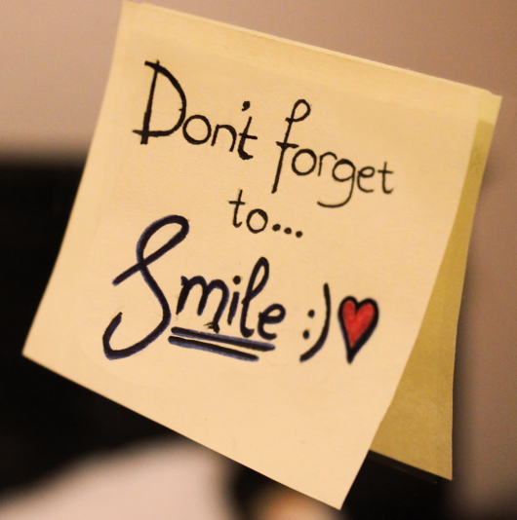
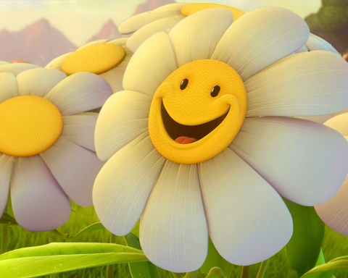
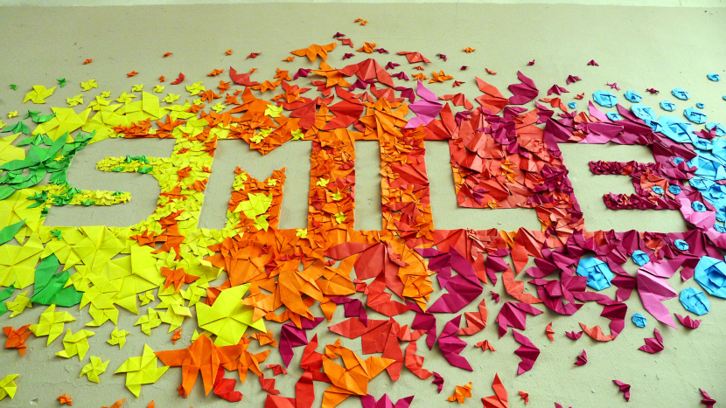
Be Respectful!
Banks Road Infant and Nursery School

Slide 9
T:
Thank you to everybody who loves me whoever they are and thank you.
Thank you for our school family and the people who help us to be the best that we can be.
.
S:
Sorry when we forget to show respect to the people that we love and to the people that take care of us.
Sorry when we forget to include everyone in the things that we do.
P:.
Please help us to be thankful for the people who help us.
Please help us always to treat people with respect.

