Slide 1
Phonics Information Evening
October 2022

Slide 2
Aims for this meeting:
Introduction to the Floppy’s Phonics Scheme.
What a phonics lesson looks like.
Correct pronunciation of sounds and the meaning behind the phonics vocabulary.
Ways you can help your child at home – including reading and the phonics folder.
Know the order of reading books and expectation for each year group.

Slide 3
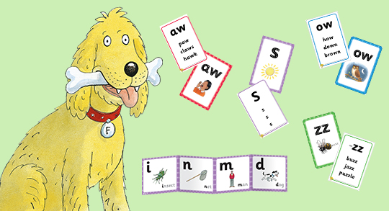
Floppy’s Phonics
Floppy’s Phonics is our new whole school phonics scheme.
The DfE has made it a statutory requirement that all schools must have a complete, systematic and synthetic programme for teaching phonics.
Phonics is a way of teaching children how to read and write. It helps children hear, identify and use different sounds that distinguish one word from another.
Notes:
Spell charfingham

Slide 4
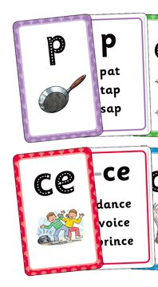
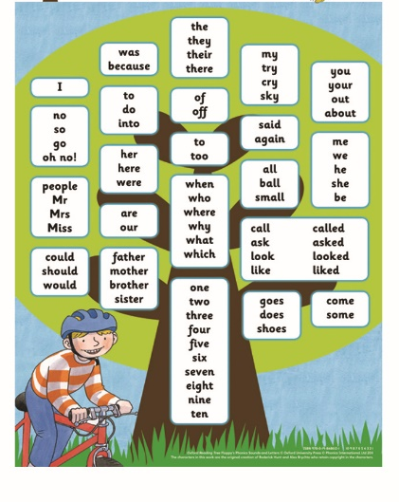
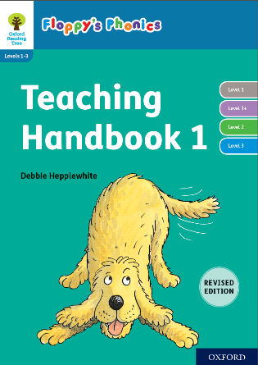
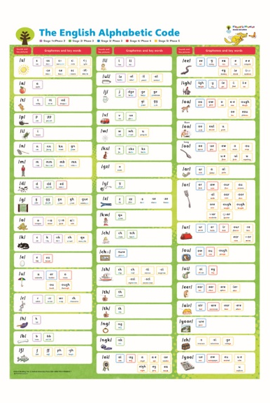
Floppy’s Phonics Resources
Frieze frames for display
Handwriting poster
Flashcards
Reading books
Helpful words poster
Planning and resource handbook
Alphabetic code poster

Slide 5
Floppy’s Phonics Vocabulary
Phoneme – The sound a letter or group of letter makes.
Grapheme – What a sound looks likes written down.
- The Alphabetic Code – This identifies the various ways the sounds can be written e.g. the sound /ch/ could also be written as ‘tch’.
Segmenting – breaking down a word into individual units of sounds.
Blending – ‘Pushing’ the sounds together to read a whole word.
Digraph – 2 letters that make 1 sound.
Trigraph – 3 letters that make 1 sound.
Quadgraph – 4 letters that make 1 sound.
Split digraph – bike cake made
Notes:
Spell charfingham

Slide 6
PURE SOUNDS!
Pronunciation of the phonemes is essential in supporting your child with their reading.
Please do not add an ‘uh’ sound to the end of phonemes.
Phonics: How to pronounce pure sounds | Oxford Owl - YouTube
Notes:
Spell charfingham

Slide 7
Floppy’s Phonics Lesson Structure
Lesson 1
Recap – This is where we will use flashcards, frieze frames or a sound sheet to do a review of what we have learnt previously.
Teach – This is where a new grapheme for a phoneme is introduced – we will model how to write it here and use the online resources to look in depth into the new grapheme and what words it appears in.
Quick Practice + Apply – This is where we will write the new grapheme in our phonics books, draw something that contains the new sound or write a word.
Lesson 2
Quick recap - using flashcards, frieze frames or a sound sheet.
Quick look at the book from the previous day – what do we remember that we found out?
Practice – reading words/captions/sentences that contain the new grapheme – this can be whole class or groups.
Apply – Specific worksheet for every child to complete – this contains a reading, writing and understanding element – this is done in groups with a teacher to support and mark as and when the children complete it so that that children can see what to work on next time.
Notes:
Spell charfingham

Slide 8
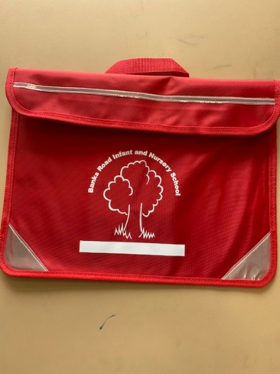
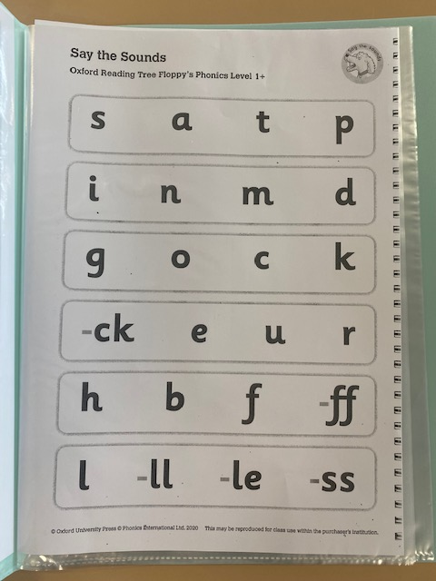
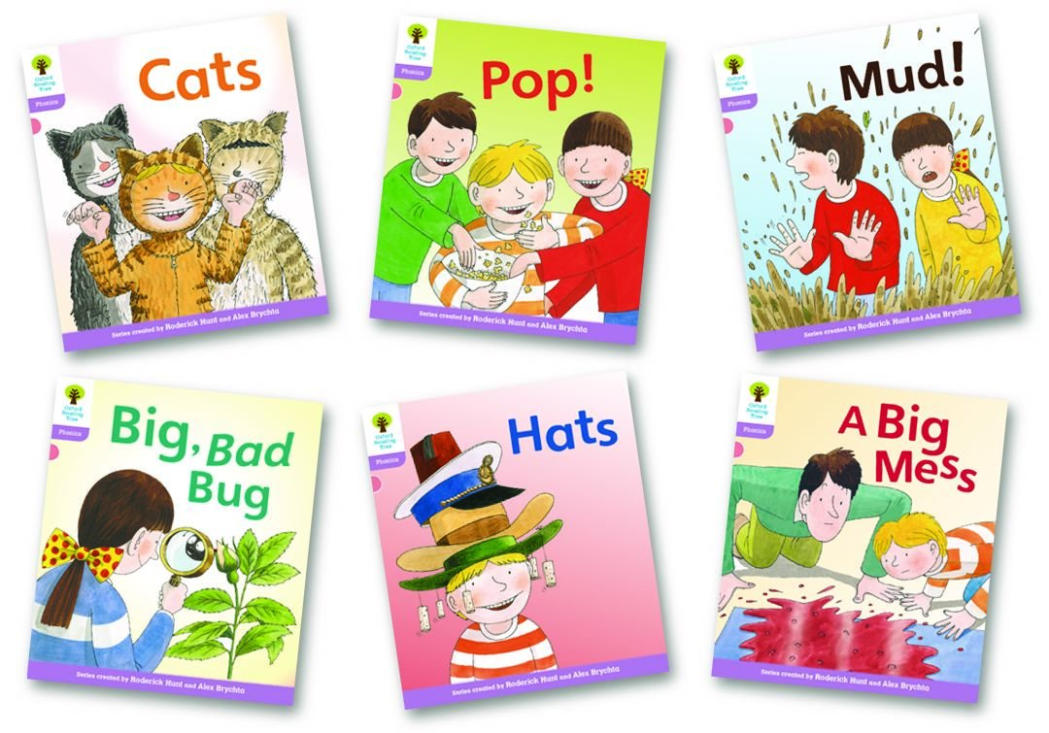
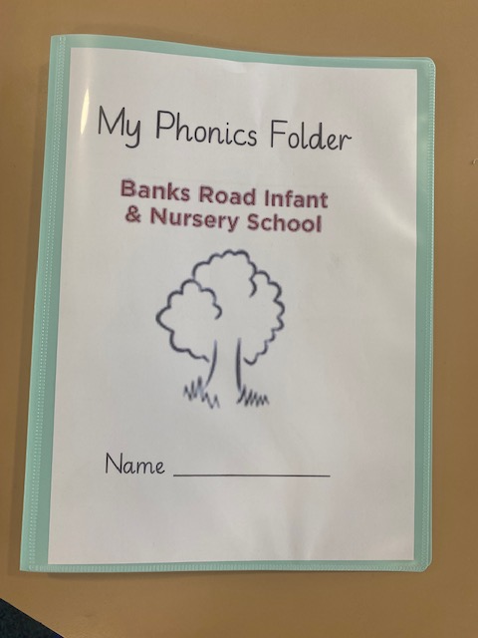
How to help your child…
These are the sheets we use in school which will be put in the phonics folder, please look at these with your child just so they can recap their learning, 5 minutes is all that’s needed!
Please bring the phonics folder inside the reading folder every day.
Please share your childs reading book with them and write in the red reading diary when you have shared the book. We change books after every 3 reads so it is important you write in the diary so we know if it is ready for a change (even a tick or smiley face will do!).

Slide 9
Reading books
Our reading books on levels Pink to Green start off sequential and follow a number system – if a child still needs a little more practice after completing all of the numbered books we have additional on each colour to continue practicing.
Orange level onwards is not sequential – children free choose books as most children by this point will be secure with their phonics.
Colour order:
Core books
Pink
Red
Yellow
Blue
Green
Orange
Turquoise
Purple
Gold
White
FS2
Year 1
Year 2

Slide 10
Any questions? Thank you for attending today!

